Slide 1
VHA EHR End-User Satisfaction

Slide 2
Agenda
Introductions and brief overview of the Arch Collaborative and its purpose
Broad look at overall results compared to other Arch participants
Identification and discussion around key findings
What best practices can we learn from other Arch members?
KLAS will answer questions already provided by the VA.
An opportunity to ask additional questions

Slide 3
Key Findings: KLAS Study of VHA Cerner Experience
Significant Challenges: KLAS has measured EHR experience in 280 organizations around the world. VHA Cerner currently has the lowest EHR experience score of any organization measured. Feedback from clinicians indicates that these challenges are stemming from two main causes:
System Response Time and Reliability: Many cite time spent, speed, and slowness among their top requested fixes. KLAS research indicates that no EHR can be successful without strong response time and reliability.
Poor EHR Training: Many felt the initial education was inadequate or “useless”. Follow-up education and tip sheets haven’t covered the gaps. KLAS research indicates that organization which invest heavily in strong training see significant rewards. This will be required for VHA to be successful.
Opportunities to Improve Current Cerner System: The Cerner EHR is a far stronger product than what has been implemented to date. KLAS has measured 55 organizations utilizing Cerner since 2017—VHA Cerner is the lowest performing Cerner site measured. Fixing stability and response challenges, adopting best practices, and investing heavier into go-live training can all drive dramatic improvements.

Slide 4
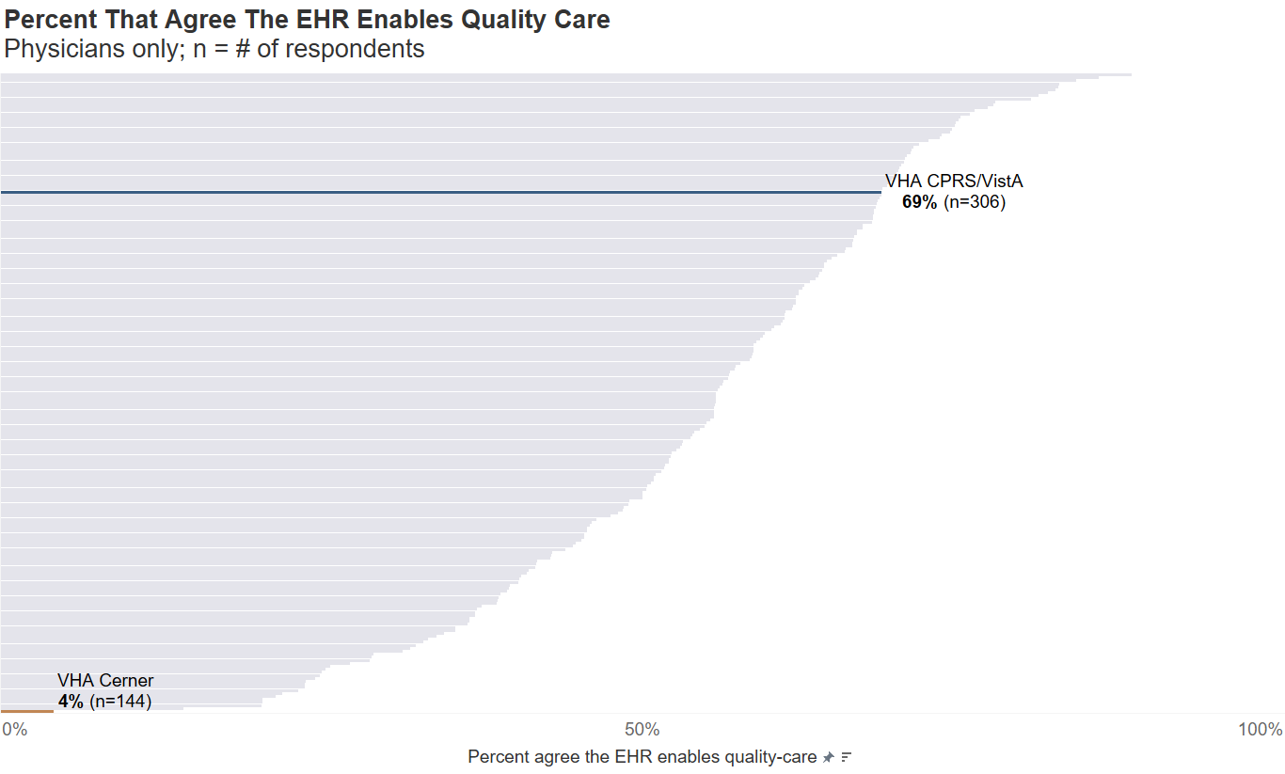
VA Cerner is the lowest performing compared to 280 Organizations world-wide

Slide 5
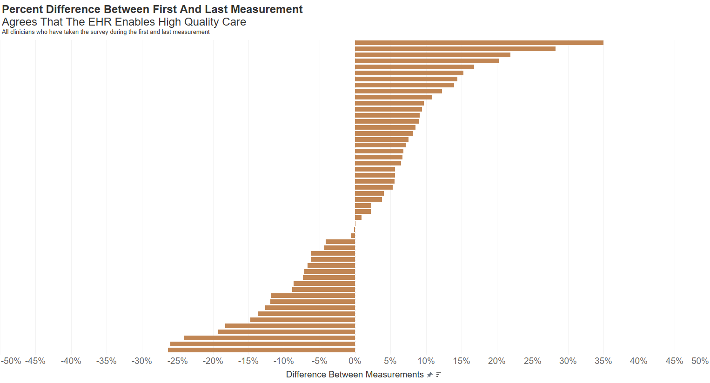
Some Arch Collaborative members have been able to dramatically improve
Arch Collaborative Findings (excludes VHA)

Slide 6
Potential action items from best practices
Adopt or create a technology that allows for real-time tracking of the infrastructure and interfaces that may affect the EHR
Adopt best practices for initial education of end-users
Teach to end-user workflows
Have 8–10 hours before go-live
A portion should be simulated or live
Reboot education for VISN 10 and VISN 20
Improve communication channels for changes and decision-making
Have a fast track for quick fixes
Ensure all end-users understand pathways
Always circle back to end-users when a request is sent

Slide 7
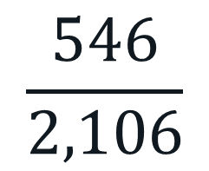
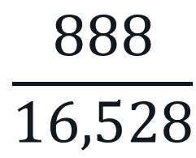
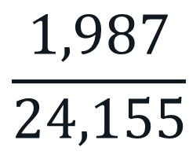
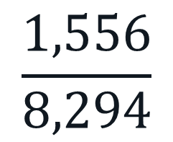
Who Did We Survey?
VISN 10
VISN 20
$$\frac{546}{2,106}$$
$$\frac{1,556}{8,294}$$
respondents
respondents
VHA Cerner
total end users
total end users
VHA CPRS/VistA
$$\frac{1,987}{24,155}$$
$$\frac{888}{16,528}$$
respondents
respondents
total end users
total end users
Notes:
~26% cerner VISN 10 and 8% CPRS/VistA
~19% cerner VISN 20 and 5% CPRS/VistA

Slide 8
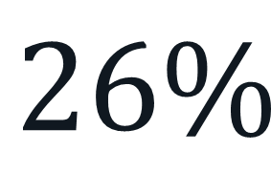



Response Rate
VISN 10
VISN 20
$$26\%$$
$$19\%$$
VHA Cerner
VHA CPRS/VistA
$$8\%$$
$$5\%$$

Slide 9
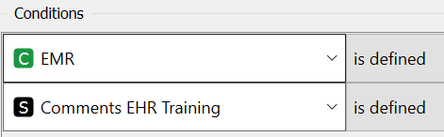
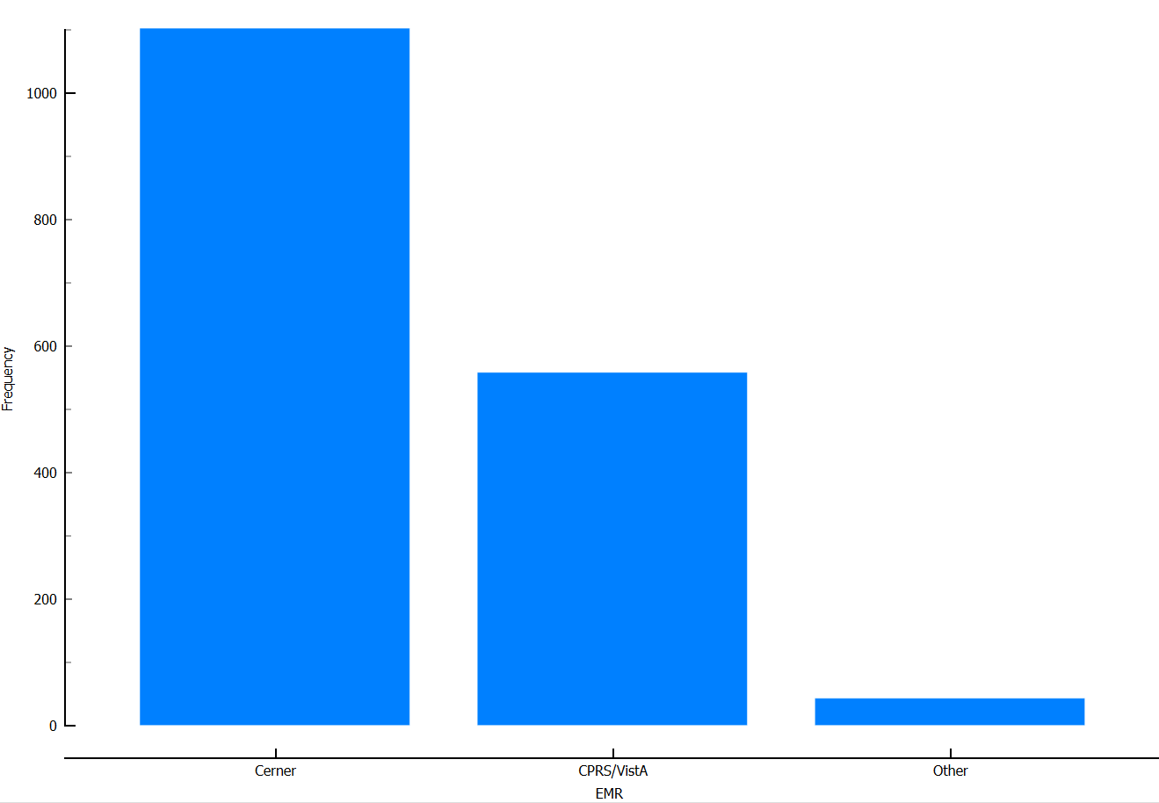
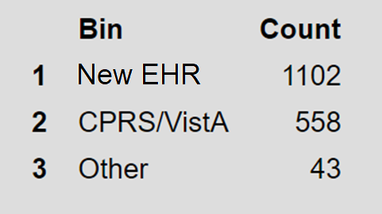
EHR Experience Survey Question -- UI8070620221 Comments about your EHR training and education
Out of 5542 total survey responses
Notes:
Out of 5542 responses
465 responses did not define EMR
3837 responses did not provide comments on EHR training
Some may have not responded to 1, or the other, or both.
Acknowledgements:
This material is the result of work supported with resources at the Veterans Affairs Office of Health Informatics Clinical Informatics and Data Management Office Human Factors Engineering Division. The views expressed in this review do not necessarily represent the views of the Department of Veterans Affairs or of the United States government. Images and figures were created using Orange: data mining toolbox in Python (Demšar et.al., 2013). We also acknowledge the work of HFE teammates for contributing to this work:
Limitations:
The content of this text analysis is intended to provide some insight into collective narratives, but is not all inclusive, nor will it capture all the intricate complexities and context. Potential themes and information should be considered, reviewed, and validated collectively by an interprofessional group when informing decision-making.
Disclaimer:
Analysis of narrative text at a point in time using various text-based analytics tools and techniques is an inexact science, the analysis may not include all of the reported cases on a specific topic. These summaries do not represent endorsement of actions by VHA CIDMO HFE. Best efforts were employed to anonymize the information contained within this presentation. However, this document may contain information that is privileged, confidential, or otherwise protected from disclosure, dissemination, distribution, or copying.
References:
1. Demšar, J., Curk, T., Erjavec, A., Gorup, Č., Hočevar, T., Milutinovič, M., ...& Zupan, B. (2013). Orange: data mining toolbox in Python. The
Journal of Machine Learning Research, 14(1), 2349-2353.
2. Arnold, T. (2022, October). Bridging Conversation Islands to Connect Healthcare: Introducing Unique Co-occurring Word Networks to Find Distinct Themes. In Proceedings of the International Symposium on Human Factors and Ergonomics in Health Care (Vol. 11, No. 1, pp. 44-47). Sage CA: Los Angeles, CA: SAGE Publications. Available at https://journals.sagepub.com/doi/pdf/10.1177/2327857922111008

Slide 10
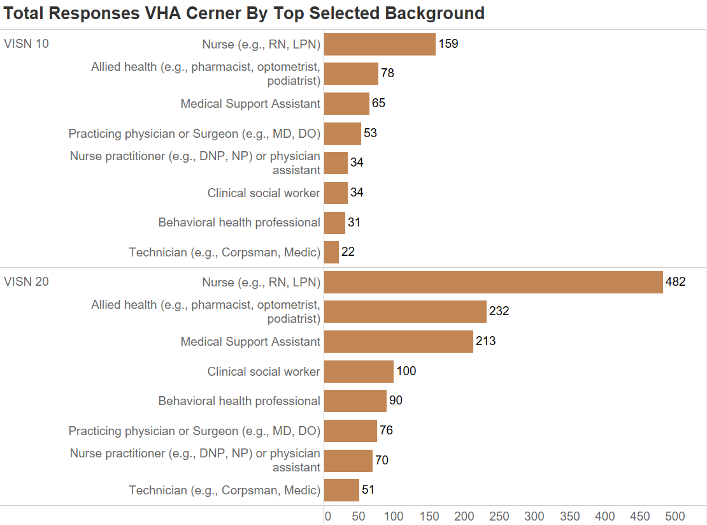

Slide 11
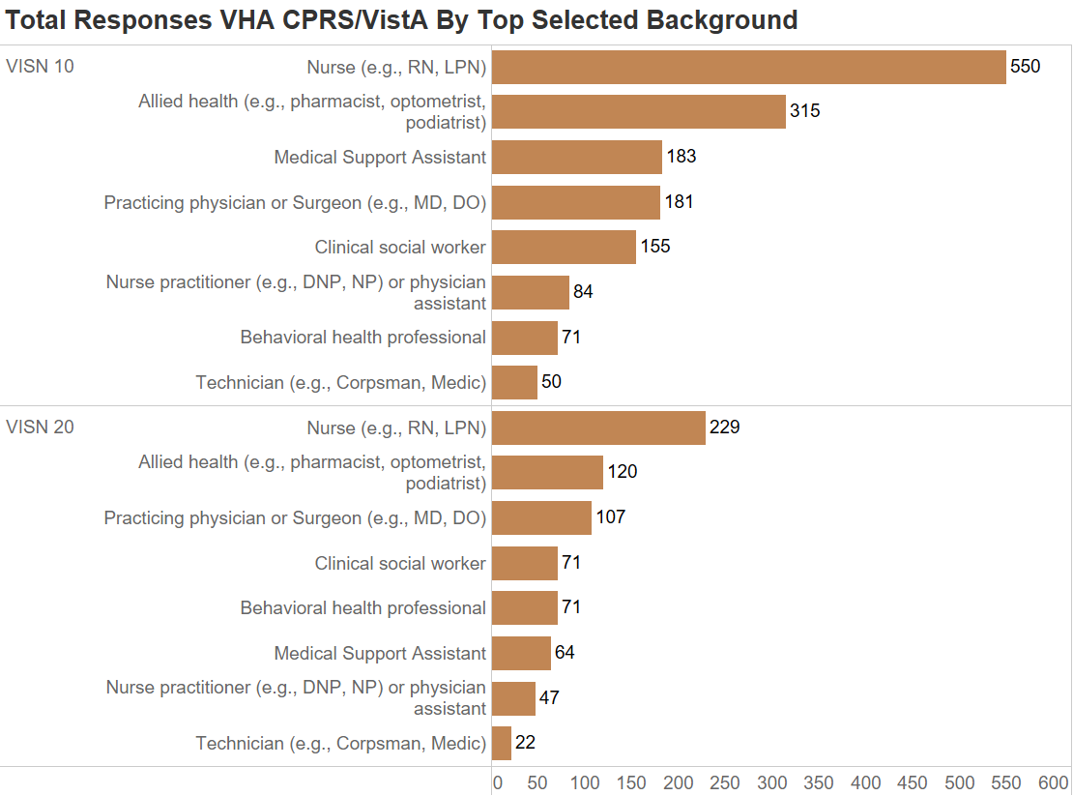

Slide 12
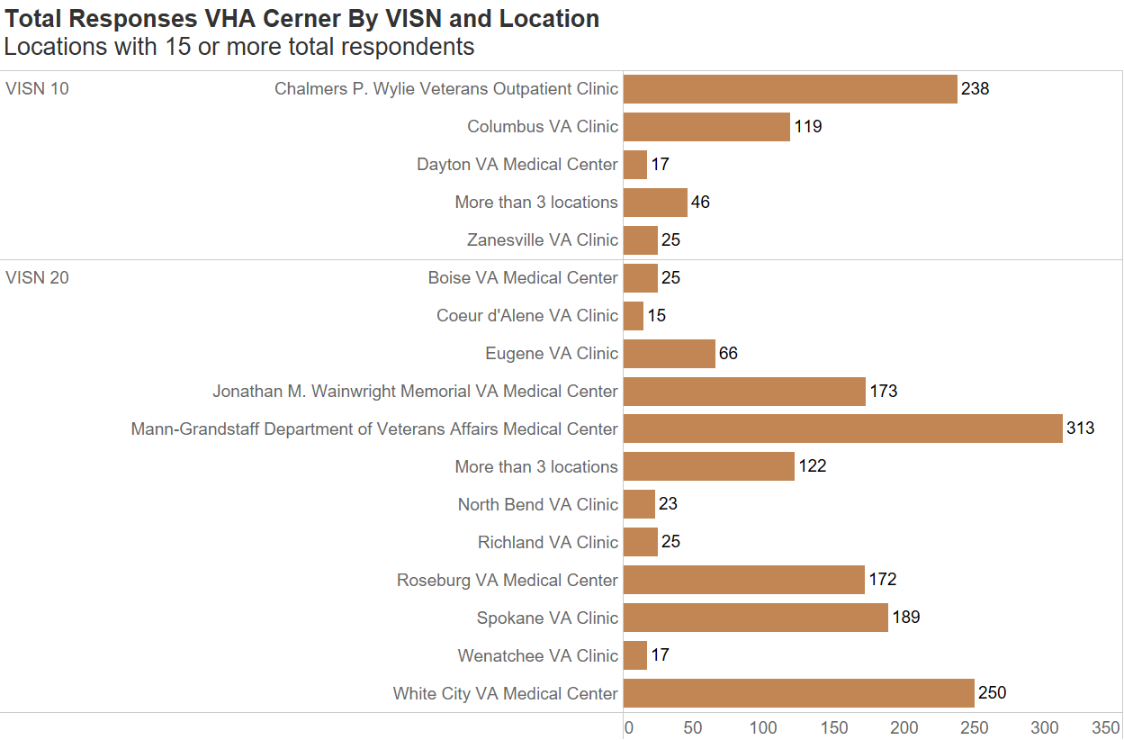

Slide 13
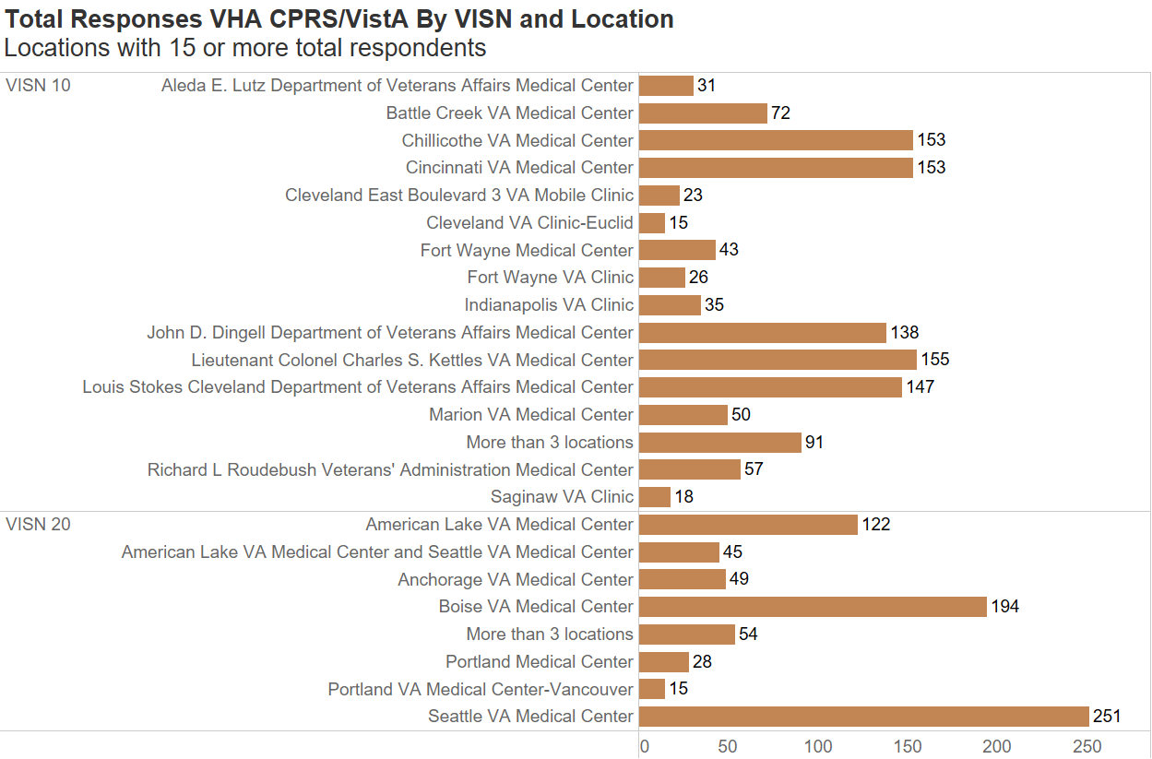

Slide 14

EHR Perception

Slide 15
Do you agree with the following statement? The Electronic Health Record enables me to deliver high-quality care

Slide 16
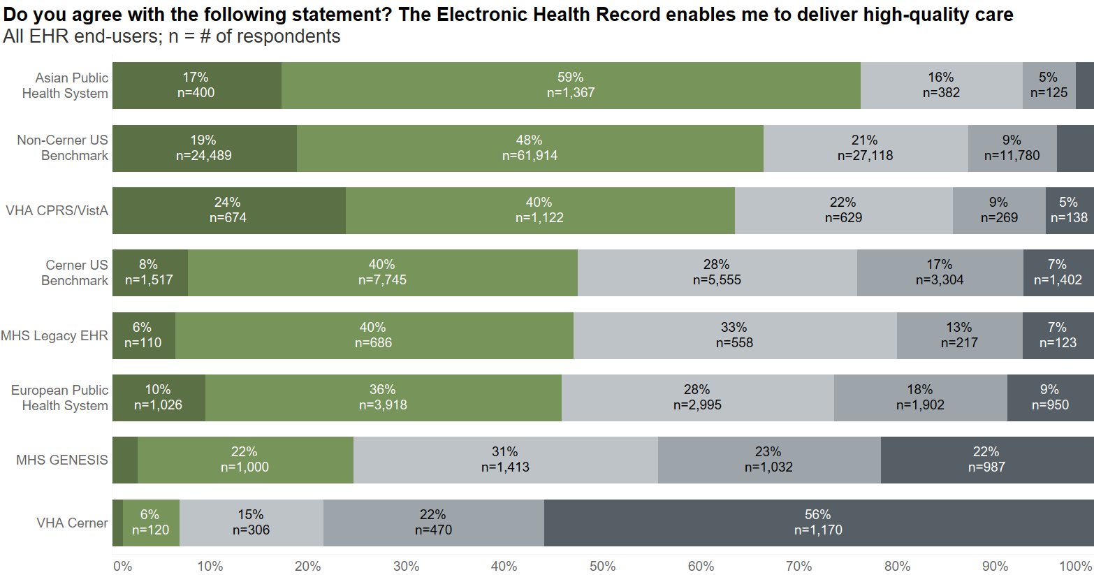
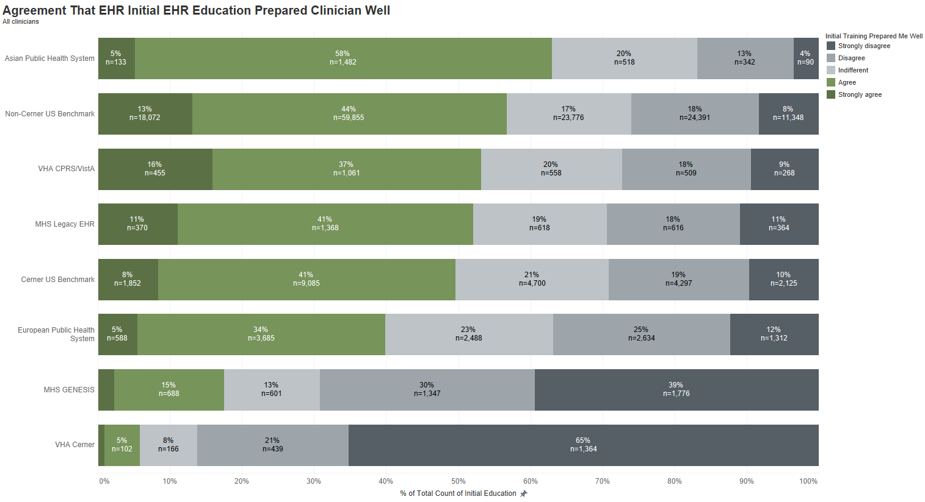
VA VistA
DOD AHLTA
DOD Cerner
VA Cerner
Notes:
% of Total Count of Satisfaction Quality Care Response along Satisfaction Quality Care Response Count of Satisfaction Quality Care Response
Asian Public Health System Strongly disagree 2% 43
Asian Public Health System Disagree 5% 125
Asian Public Health System Indifferent 16% 382
Asian Public Health System Agree 59% 1,367
Asian Public Health System Strongly agree 17% 400
Non-Cerner US Benchmark Strongly disagree 4% 4,867
Non-Cerner US Benchmark Disagree 9% 11,780
Non-Cerner US Benchmark Indifferent 21% 27,118
Non-Cerner US Benchmark Agree 48% 61,914
Non-Cerner US Benchmark Strongly agree 19% 24,489
VHA CPRS/VistA Strongly disagree 5% 138
VHA CPRS/VistA Disagree 9% 269
VHA CPRS/VistA Indifferent 22% 629
VHA CPRS/VistA Agree 40% 1,122
VHA CPRS/VistA Strongly agree 24% 674
Cerner US Benchmark Strongly disagree 7% 1,402
Cerner US Benchmark Disagree 17% 3,304
Cerner US Benchmark Indifferent 28% 5,555
Cerner US Benchmark Agree 40% 7,745
Cerner US Benchmark Strongly agree 8% 1,517
MHS Legacy EHR Strongly disagree 7% 123
MHS Legacy EHR Disagree 13% 217
MHS Legacy EHR Indifferent 33% 558
MHS Legacy EHR Agree 40% 686
MHS Legacy EHR Strongly agree 6% 110
European Public Health System Strongly disagree 9% 950
European Public Health System Disagree 18% 1,902
European Public Health System Indifferent 28% 2,995
European Public Health System Agree 36% 3,918
European Public Health System Strongly agree 10% 1,026
MHS GENESIS Strongly disagree 22% 987
MHS GENESIS Disagree 23% 1,032
MHS GENESIS Indifferent 31% 1,413
MHS GENESIS Agree 22% 1,000
MHS GENESIS Strongly agree 3% 120
VHA Cerner Strongly disagree 56% 1,170
VHA Cerner Disagree 22% 470
VHA Cerner Indifferent 15% 306
VHA Cerner Agree 6% 120
VHA Cerner Strongly agree 1% 24

Slide 17
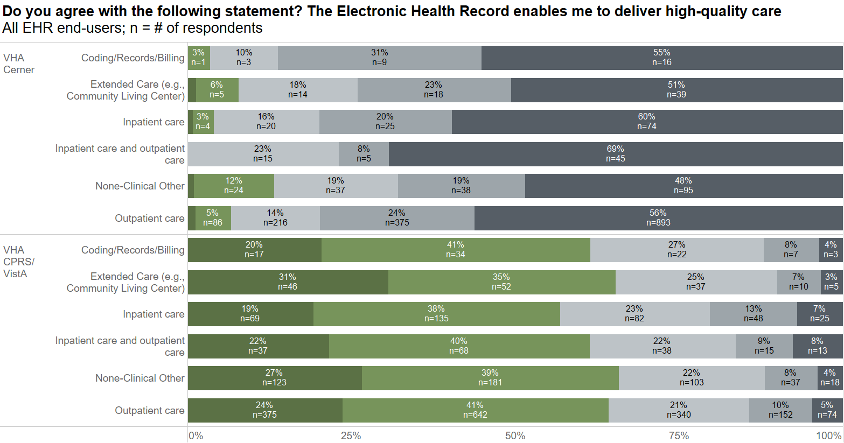
Notes:
% of Total Count of The electronic health record enables me to deliver high quality care. along The electronic health record enables me to deliver high quality care. Count of The electronic health record enables me to deliver high quality care.
VHA Cerner Coding/Records/Billing Strongly disagree 55% 16.0
VHA Cerner Coding/Records/Billing Disagree 31% 9.0
VHA Cerner Coding/Records/Billing Indifferent 10% 3.0
VHA Cerner Coding/Records/Billing Agree 3% 1.0
VHA Cerner Extended Care (e.g., Community Living Center) Strongly disagree 51% 39.0
VHA Cerner Extended Care (e.g., Community Living Center) Disagree 23% 18.0
VHA Cerner Extended Care (e.g., Community Living Center) Indifferent 18% 14.0
VHA Cerner Extended Care (e.g., Community Living Center) Agree 6% 5.0
VHA Cerner Extended Care (e.g., Community Living Center) Strongly agree 1% 1.0
VHA Cerner Inpatient care Strongly disagree 60% 74.0
VHA Cerner Inpatient care Disagree 20% 25.0
VHA Cerner Inpatient care Indifferent 16% 20.0
VHA Cerner Inpatient care Agree 3% 4.0
VHA Cerner Inpatient care Strongly agree 1% 1.0
VHA Cerner Inpatient care and outpatient care Strongly disagree 69% 45.0
VHA Cerner Inpatient care and outpatient care Disagree 8% 5.0
VHA Cerner Inpatient care and outpatient care Indifferent 23% 15.0
VHA Cerner None-Clinical Other Strongly disagree 48% 95.0
VHA Cerner None-Clinical Other Disagree 19% 38.0
VHA Cerner None-Clinical Other Indifferent 19% 37.0
VHA Cerner None-Clinical Other Agree 12% 24.0
VHA Cerner None-Clinical Other Strongly agree 1% 2.0
VHA Cerner Outpatient care Strongly disagree 56% 893.0
VHA Cerner Outpatient care Disagree 24% 375.0
VHA Cerner Outpatient care Indifferent 14% 216.0
VHA Cerner Outpatient care Agree 5% 86.0
VHA Cerner Outpatient care Strongly agree 1% 20.0
VHA CPRS/VistA Coding/Records/Billing Strongly disagree 4% 3.0
VHA CPRS/VistA Coding/Records/Billing Disagree 8% 7.0
VHA CPRS/VistA Coding/Records/Billing Indifferent 27% 22.0
VHA CPRS/VistA Coding/Records/Billing Agree 41% 34.0
VHA CPRS/VistA Coding/Records/Billing Strongly agree 20% 17.0
VHA CPRS/VistA Extended Care (e.g., Community Living Center) Strongly disagree 3% 5.0
VHA CPRS/VistA Extended Care (e.g., Community Living Center) Disagree 7% 10.0
VHA CPRS/VistA Extended Care (e.g., Community Living Center) Indifferent 25% 37.0
VHA CPRS/VistA Extended Care (e.g., Community Living Center) Agree 35% 52.0
VHA CPRS/VistA Extended Care (e.g., Community Living Center) Strongly agree 31% 46.0
VHA CPRS/VistA Inpatient care Strongly disagree 7% 25.0
VHA CPRS/VistA Inpatient care Disagree 13% 48.0
VHA CPRS/VistA Inpatient care Indifferent 23% 82.0
VHA CPRS/VistA Inpatient care Agree 38% 135.0
VHA CPRS/VistA Inpatient care Strongly agree 19% 69.0
VHA CPRS/VistA Inpatient care and outpatient care Strongly disagree 8% 13.0
VHA CPRS/VistA Inpatient care and outpatient care Disagree 9% 15.0
VHA CPRS/VistA Inpatient care and outpatient care Indifferent 22% 38.0
VHA CPRS/VistA Inpatient care and outpatient care Agree 40% 68.0
VHA CPRS/VistA Inpatient care and outpatient care Strongly agree 22% 37.0
VHA CPRS/VistA None-Clinical Other Strongly disagree 4% 18.0
VHA CPRS/VistA None-Clinical Other Disagree 8% 37.0
VHA CPRS/VistA None-Clinical Other Indifferent 22% 103.0
VHA CPRS/VistA None-Clinical Other Agree 39% 181.0
VHA CPRS/VistA None-Clinical Other Strongly agree 27% 123.0
VHA CPRS/VistA Outpatient care Strongly disagree 5% 74.0
VHA CPRS/VistA Outpatient care Disagree 10% 152.0
VHA CPRS/VistA Outpatient care Indifferent 21% 340.0
VHA CPRS/VistA Outpatient care Agree 41% 642.0
VHA CPRS/VistA Outpatient care Strongly agree 24% 375.0

Slide 18
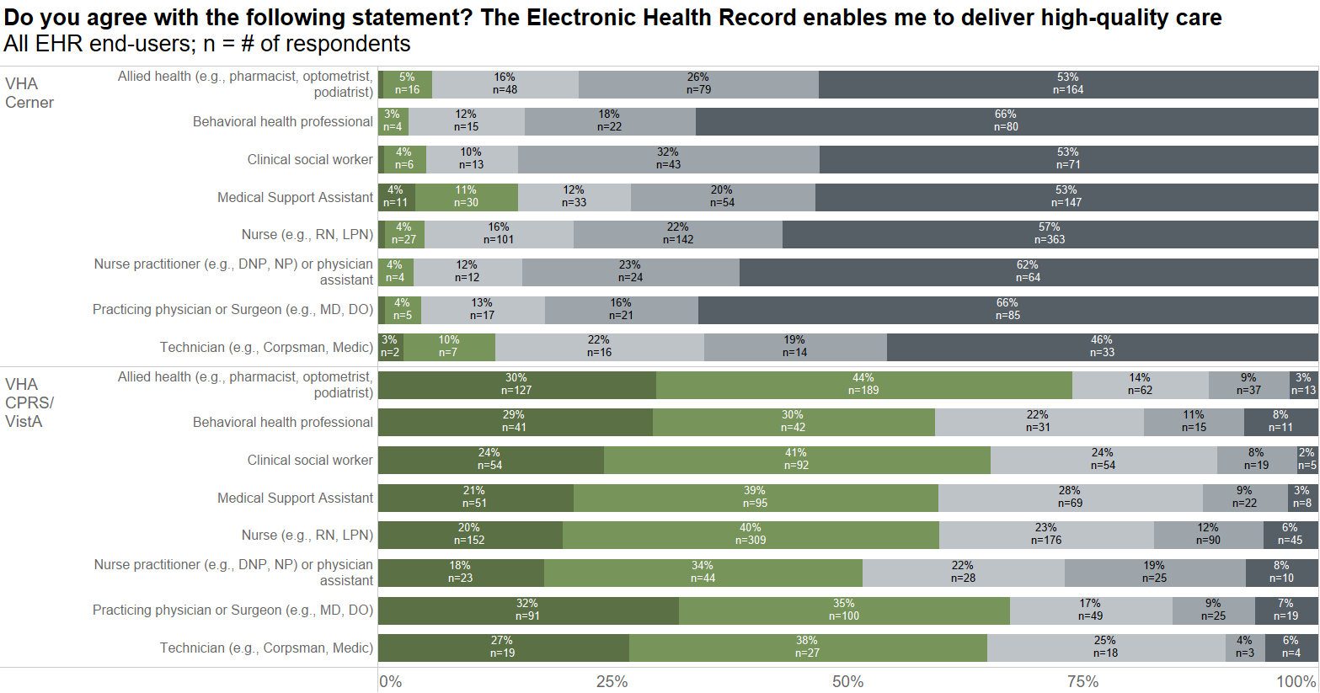
Notes:
% of Total Count of The electronic health record enables me to deliver high quality care. along The electronic health record enables me to deliver high quality care. Count of The electronic health record enables me to deliver high quality care.
VHA Cerner Allied health (e.g., pharmacist, optometrist, podiatrist) Strongly disagree 53% 164.0
VHA Cerner Allied health (e.g., pharmacist, optometrist, podiatrist) Disagree 26% 79.0
VHA Cerner Allied health (e.g., pharmacist, optometrist, podiatrist) Indifferent 16% 48.0
VHA Cerner Allied health (e.g., pharmacist, optometrist, podiatrist) Agree 5% 16.0
VHA Cerner Allied health (e.g., pharmacist, optometrist, podiatrist) Strongly agree 1% 2.0
VHA Cerner Behavioral health professional Strongly disagree 66% 80.0
VHA Cerner Behavioral health professional Disagree 18% 22.0
VHA Cerner Behavioral health professional Indifferent 12% 15.0
VHA Cerner Behavioral health professional Agree 3% 4.0
VHA Cerner Clinical social worker Strongly disagree 53% 71.0
VHA Cerner Clinical social worker Disagree 32% 43.0
VHA Cerner Clinical social worker Indifferent 10% 13.0
VHA Cerner Clinical social worker Agree 4% 6.0
VHA Cerner Clinical social worker Strongly agree 1% 1.0
VHA Cerner Medical Support Assistant Strongly disagree 53% 147.0
VHA Cerner Medical Support Assistant Disagree 20% 54.0
VHA Cerner Medical Support Assistant Indifferent 12% 33.0
VHA Cerner Medical Support Assistant Agree 11% 30.0
VHA Cerner Medical Support Assistant Strongly agree 4% 11.0
VHA Cerner Nurse (e.g., RN, LPN) Strongly disagree 57% 363.0
VHA Cerner Nurse (e.g., RN, LPN) Disagree 22% 142.0
VHA Cerner Nurse (e.g., RN, LPN) Indifferent 16% 101.0
VHA Cerner Nurse (e.g., RN, LPN) Agree 4% 27.0
VHA Cerner Nurse (e.g., RN, LPN) Strongly agree 1% 5.0
VHA Cerner Nurse practitioner (e.g., DNP, NP) or physician assistant Strongly disagree 62% 64.0
VHA Cerner Nurse practitioner (e.g., DNP, NP) or physician assistant Disagree 23% 24.0
VHA Cerner Nurse practitioner (e.g., DNP, NP) or physician assistant Indifferent 12% 12.0
VHA Cerner Nurse practitioner (e.g., DNP, NP) or physician assistant Agree 4% 4.0
VHA Cerner Practicing physician or Surgeon (e.g., MD, DO) Strongly disagree 66% 85.0
VHA Cerner Practicing physician or Surgeon (e.g., MD, DO) Disagree 16% 21.0
VHA Cerner Practicing physician or Surgeon (e.g., MD, DO) Indifferent 13% 17.0
VHA Cerner Practicing physician or Surgeon (e.g., MD, DO) Agree 4% 5.0
VHA Cerner Practicing physician or Surgeon (e.g., MD, DO) Strongly agree 1% 1.0
VHA Cerner Technician (e.g., Corpsman, Medic) Strongly disagree 46% 33.0
VHA Cerner Technician (e.g., Corpsman, Medic) Disagree 19% 14.0
VHA Cerner Technician (e.g., Corpsman, Medic) Indifferent 22% 16.0
VHA Cerner Technician (e.g., Corpsman, Medic) Agree 10% 7.0
VHA Cerner Technician (e.g., Corpsman, Medic) Strongly agree 3% 2.0
VHA CPRS/VistA Allied health (e.g., pharmacist, optometrist, podiatrist) Strongly disagree 3% 13.0
VHA CPRS/VistA Allied health (e.g., pharmacist, optometrist, podiatrist) Disagree 9% 37.0
VHA CPRS/VistA Allied health (e.g., pharmacist, optometrist, podiatrist) Indifferent 14% 62.0
VHA CPRS/VistA Allied health (e.g., pharmacist, optometrist, podiatrist) Agree 44% 189.0
VHA CPRS/VistA Allied health (e.g., pharmacist, optometrist, podiatrist) Strongly agree 30% 127.0
VHA CPRS/VistA Behavioral health professional Strongly disagree 8% 11.0
VHA CPRS/VistA Behavioral health professional Disagree 11% 15.0
VHA CPRS/VistA Behavioral health professional Indifferent 22% 31.0
VHA CPRS/VistA Behavioral health professional Agree 30% 42.0
VHA CPRS/VistA Behavioral health professional Strongly agree 29% 41.0
VHA CPRS/VistA Clinical social worker Strongly disagree 2% 5.0
VHA CPRS/VistA Clinical social worker Disagree 8% 19.0
VHA CPRS/VistA Clinical social worker Indifferent 24% 54.0
VHA CPRS/VistA Clinical social worker Agree 41% 92.0
VHA CPRS/VistA Clinical social worker Strongly agree 24% 54.0
VHA CPRS/VistA Medical Support Assistant Strongly disagree 3% 8.0
VHA CPRS/VistA Medical Support Assistant Disagree 9% 22.0
VHA CPRS/VistA Medical Support Assistant Indifferent 28% 69.0
VHA CPRS/VistA Medical Support Assistant Agree 39% 95.0
VHA CPRS/VistA Medical Support Assistant Strongly agree 21% 51.0
VHA CPRS/VistA Nurse (e.g., RN, LPN) Strongly disagree 6% 45.0
VHA CPRS/VistA Nurse (e.g., RN, LPN) Disagree 12% 90.0
VHA CPRS/VistA Nurse (e.g., RN, LPN) Indifferent 23% 176.0
VHA CPRS/VistA Nurse (e.g., RN, LPN) Agree 40% 309.0
VHA CPRS/VistA Nurse (e.g., RN, LPN) Strongly agree 20% 152.0
VHA CPRS/VistA Nurse practitioner (e.g., DNP, NP) or physician assistant Strongly disagree 8% 10.0
VHA CPRS/VistA Nurse practitioner (e.g., DNP, NP) or physician assistant Disagree 19% 25.0
VHA CPRS/VistA Nurse practitioner (e.g., DNP, NP) or physician assistant Indifferent 22% 28.0
VHA CPRS/VistA Nurse practitioner (e.g., DNP, NP) or physician assistant Agree 34% 44.0
VHA CPRS/VistA Nurse practitioner (e.g., DNP, NP) or physician assistant Strongly agree 18% 23.0
VHA CPRS/VistA Practicing physician or Surgeon (e.g., MD, DO) Strongly disagree 7% 19.0
VHA CPRS/VistA Practicing physician or Surgeon (e.g., MD, DO) Disagree 9% 25.0
VHA CPRS/VistA Practicing physician or Surgeon (e.g., MD, DO) Indifferent 17% 49.0
VHA CPRS/VistA Practicing physician or Surgeon (e.g., MD, DO) Agree 35% 100.0
VHA CPRS/VistA Practicing physician or Surgeon (e.g., MD, DO) Strongly agree 32% 91.0
VHA CPRS/VistA Technician (e.g., Corpsman, Medic) Strongly disagree 6% 4.0
VHA CPRS/VistA Technician (e.g., Corpsman, Medic) Disagree 4% 3.0
VHA CPRS/VistA Technician (e.g., Corpsman, Medic) Indifferent 25% 18.0
VHA CPRS/VistA Technician (e.g., Corpsman, Medic) Agree 38% 27.0
VHA CPRS/VistA Technician (e.g., Corpsman, Medic) Strongly agree 27% 19.0

Slide 19
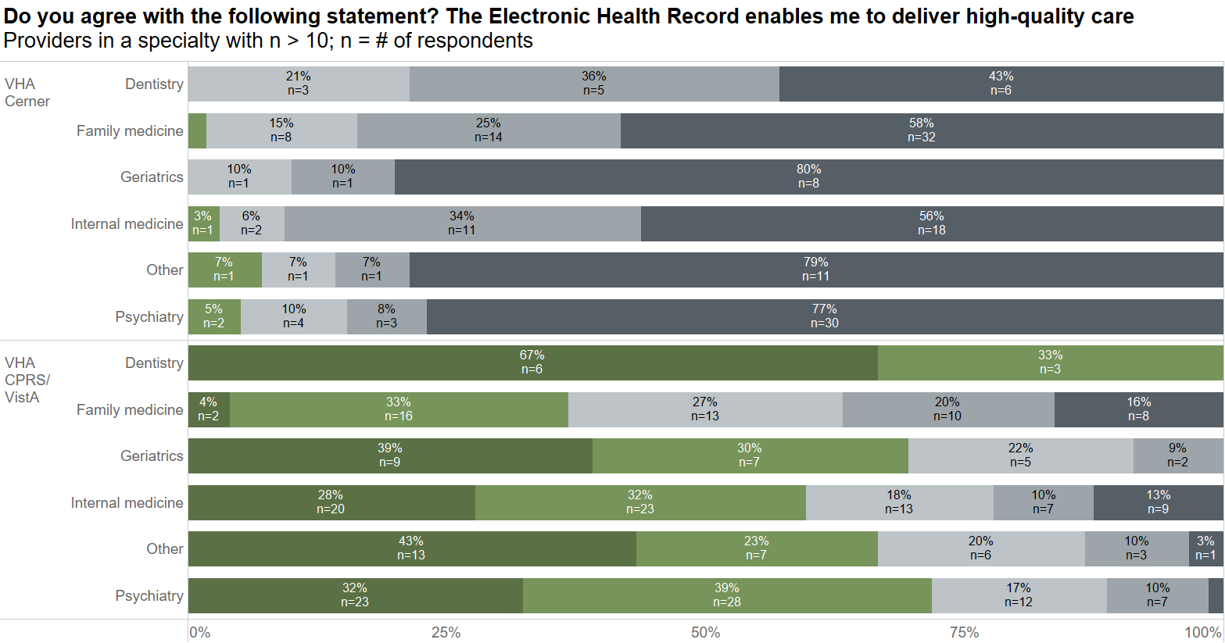
Notes:
% of Total Count of The electronic health record enables me to deliver high quality care. along The electronic health record enables me to deliver high quality care. Count of The electronic health record enables me to deliver high quality care.
VHA Cerner Dentistry Strongly disagree 43% 6.00
VHA Cerner Dentistry Disagree 36% 5.00
VHA Cerner Dentistry Indifferent 21% 3.00
VHA Cerner Family medicine Strongly disagree 58% 32.00
VHA Cerner Family medicine Disagree 25% 14.00
VHA Cerner Family medicine Indifferent 15% 8.00
VHA Cerner Family medicine Agree 2% 1.00
VHA Cerner Geriatrics Strongly disagree 80% 8.00
VHA Cerner Geriatrics Disagree 10% 1.00
VHA Cerner Geriatrics Indifferent 10% 1.00
VHA Cerner Internal medicine Strongly disagree 56% 18.00
VHA Cerner Internal medicine Disagree 34% 11.00
VHA Cerner Internal medicine Indifferent 6% 2.00
VHA Cerner Internal medicine Agree 3% 1.00
VHA Cerner Other Strongly disagree 79% 11.00
VHA Cerner Other Disagree 7% 1.00
VHA Cerner Other Indifferent 7% 1.00
VHA Cerner Other Agree 7% 1.00
VHA Cerner Psychiatry Strongly disagree 77% 30.00
VHA Cerner Psychiatry Disagree 8% 3.00
VHA Cerner Psychiatry Indifferent 10% 4.00
VHA Cerner Psychiatry Agree 5% 2.00
VHA CPRS/VistA Dentistry Agree 33% 3.00
VHA CPRS/VistA Dentistry Strongly agree 67% 6.00
VHA CPRS/VistA Family medicine Strongly disagree 16% 8.00
VHA CPRS/VistA Family medicine Disagree 20% 10.00
VHA CPRS/VistA Family medicine Indifferent 27% 13.00
VHA CPRS/VistA Family medicine Agree 33% 16.00
VHA CPRS/VistA Family medicine Strongly agree 4% 2.00
VHA CPRS/VistA Geriatrics Disagree 9% 2.00
VHA CPRS/VistA Geriatrics Indifferent 22% 5.00
VHA CPRS/VistA Geriatrics Agree 30% 7.00
VHA CPRS/VistA Geriatrics Strongly agree 39% 9.00
VHA CPRS/VistA Internal medicine Strongly disagree 13% 9.00
VHA CPRS/VistA Internal medicine Disagree 10% 7.00
VHA CPRS/VistA Internal medicine Indifferent 18% 13.00
VHA CPRS/VistA Internal medicine Agree 32% 23.00
VHA CPRS/VistA Internal medicine Strongly agree 28% 20.00
VHA CPRS/VistA Other Strongly disagree 3% 1.00
VHA CPRS/VistA Other Disagree 10% 3.00
VHA CPRS/VistA Other Indifferent 20% 6.00
VHA CPRS/VistA Other Agree 23% 7.00
VHA CPRS/VistA Other Strongly agree 43% 13.00
VHA CPRS/VistA Psychiatry Strongly disagree 1% 1.00
VHA CPRS/VistA Psychiatry Disagree 10% 7.00
VHA CPRS/VistA Psychiatry Indifferent 17% 12.00
VHA CPRS/VistA Psychiatry Agree 39% 28.00
VHA CPRS/VistA Psychiatry Strongly agree 32% 23.00

Slide 20
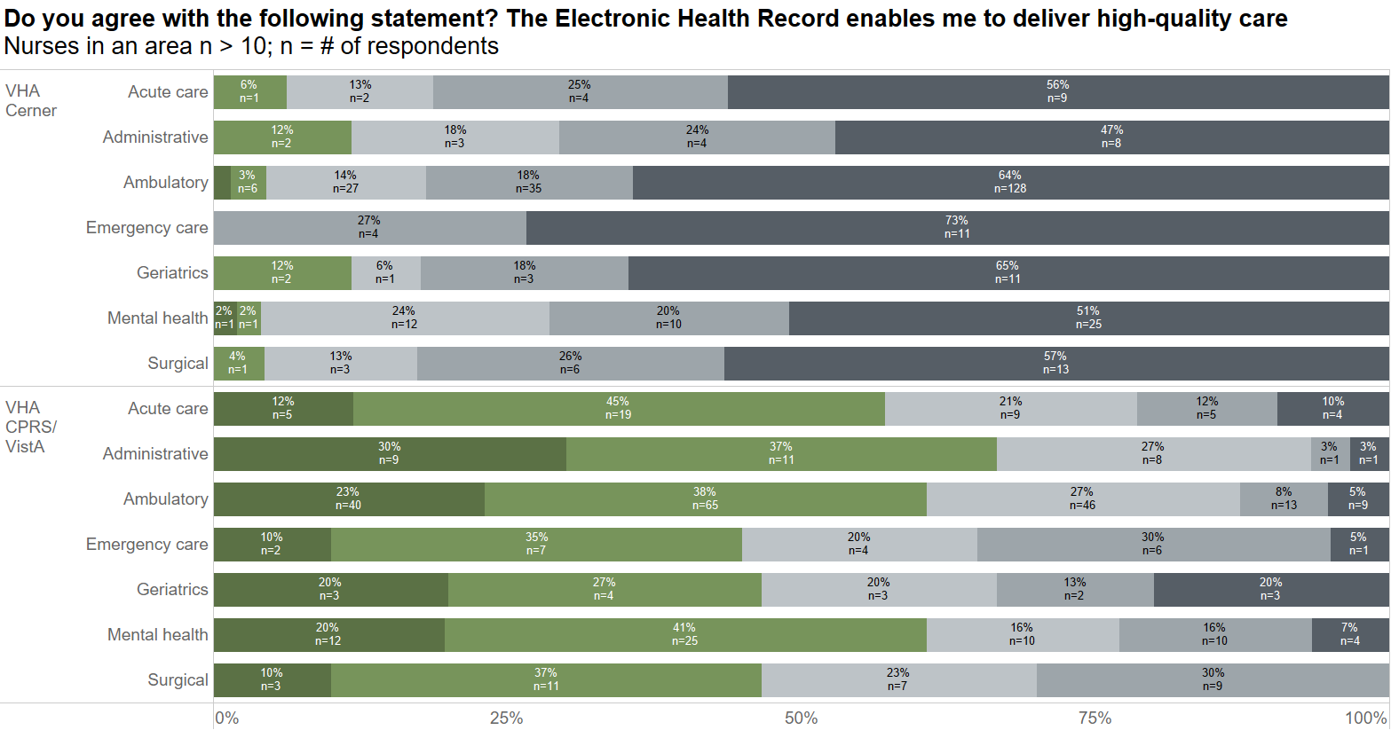
Notes:
% of Total Count of The electronic health record enables me to deliver high quality care. along The electronic health record enables me to deliver high quality care. Count of The electronic health record enables me to deliver high quality care.
VHA Cerner Acute care Strongly disagree 56% 9.0
VHA Cerner Acute care Disagree 25% 4.0
VHA Cerner Acute care Indifferent 13% 2.0
VHA Cerner Acute care Agree 6% 1.0
VHA Cerner Administrative Strongly disagree 47% 8.0
VHA Cerner Administrative Disagree 24% 4.0
VHA Cerner Administrative Indifferent 18% 3.0
VHA Cerner Administrative Agree 12% 2.0
VHA Cerner Ambulatory Strongly disagree 64% 128.0
VHA Cerner Ambulatory Disagree 18% 35.0
VHA Cerner Ambulatory Indifferent 14% 27.0
VHA Cerner Ambulatory Agree 3% 6.0
VHA Cerner Ambulatory Strongly agree 2% 3.0
VHA Cerner Emergency care Strongly disagree 73% 11.0
VHA Cerner Emergency care Disagree 27% 4.0
VHA Cerner Geriatrics Strongly disagree 65% 11.0
VHA Cerner Geriatrics Disagree 18% 3.0
VHA Cerner Geriatrics Indifferent 6% 1.0
VHA Cerner Geriatrics Agree 12% 2.0
VHA Cerner Mental health Strongly disagree 51% 25.0
VHA Cerner Mental health Disagree 20% 10.0
VHA Cerner Mental health Indifferent 24% 12.0
VHA Cerner Mental health Agree 2% 1.0
VHA Cerner Mental health Strongly agree 2% 1.0
VHA Cerner Surgical Strongly disagree 57% 13.0
VHA Cerner Surgical Disagree 26% 6.0
VHA Cerner Surgical Indifferent 13% 3.0
VHA Cerner Surgical Agree 4% 1.0
VHA CPRS/VistA Acute care Strongly disagree 10% 4.0
VHA CPRS/VistA Acute care Disagree 12% 5.0
VHA CPRS/VistA Acute care Indifferent 21% 9.0
VHA CPRS/VistA Acute care Agree 45% 19.0
VHA CPRS/VistA Acute care Strongly agree 12% 5.0
VHA CPRS/VistA Administrative Strongly disagree 3% 1.0
VHA CPRS/VistA Administrative Disagree 3% 1.0
VHA CPRS/VistA Administrative Indifferent 27% 8.0
VHA CPRS/VistA Administrative Agree 37% 11.0
VHA CPRS/VistA Administrative Strongly agree 30% 9.0
VHA CPRS/VistA Ambulatory Strongly disagree 5% 9.0
VHA CPRS/VistA Ambulatory Disagree 8% 13.0
VHA CPRS/VistA Ambulatory Indifferent 27% 46.0
VHA CPRS/VistA Ambulatory Agree 38% 65.0
VHA CPRS/VistA Ambulatory Strongly agree 23% 40.0
VHA CPRS/VistA Emergency care Strongly disagree 5% 1.0
VHA CPRS/VistA Emergency care Disagree 30% 6.0
VHA CPRS/VistA Emergency care Indifferent 20% 4.0
VHA CPRS/VistA Emergency care Agree 35% 7.0
VHA CPRS/VistA Emergency care Strongly agree 10% 2.0
VHA CPRS/VistA Geriatrics Strongly disagree 20% 3.0
VHA CPRS/VistA Geriatrics Disagree 13% 2.0
VHA CPRS/VistA Geriatrics Indifferent 20% 3.0
VHA CPRS/VistA Geriatrics Agree 27% 4.0
VHA CPRS/VistA Geriatrics Strongly agree 20% 3.0
VHA CPRS/VistA Mental health Strongly disagree 7% 4.0
VHA CPRS/VistA Mental health Disagree 16% 10.0
VHA CPRS/VistA Mental health Indifferent 16% 10.0
VHA CPRS/VistA Mental health Agree 41% 25.0
VHA CPRS/VistA Mental health Strongly agree 20% 12.0
VHA CPRS/VistA Surgical Disagree 30% 9.0
VHA CPRS/VistA Surgical Indifferent 23% 7.0
VHA CPRS/VistA Surgical Agree 37% 11.0
VHA CPRS/VistA Surgical Strongly agree 10% 3.0

Slide 21
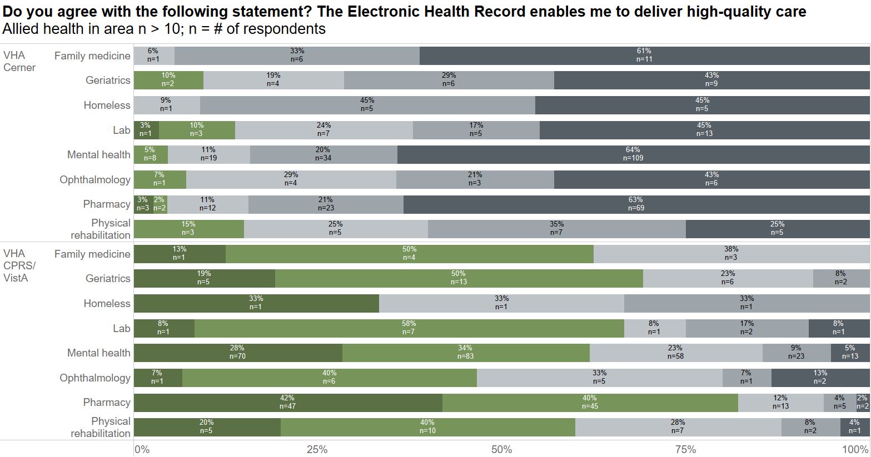
Notes:
% of Total Count of The electronic health record enables me to deliver high quality care. along The electronic health record enables me to deliver high quality care. Count of The electronic health record enables me to deliver high quality care.
VHA Cerner Family medicine Strongly disagree 61% 11.0
VHA Cerner Family medicine Disagree 33% 6.0
VHA Cerner Family medicine Indifferent 6% 1.0
VHA Cerner Geriatrics Strongly disagree 43% 9.0
VHA Cerner Geriatrics Disagree 29% 6.0
VHA Cerner Geriatrics Indifferent 19% 4.0
VHA Cerner Geriatrics Agree 10% 2.0
VHA Cerner Homeless Strongly disagree 45% 5.0
VHA Cerner Homeless Disagree 45% 5.0
VHA Cerner Homeless Indifferent 9% 1.0
VHA Cerner Lab Strongly disagree 45% 13.0
VHA Cerner Lab Disagree 17% 5.0
VHA Cerner Lab Indifferent 24% 7.0
VHA Cerner Lab Agree 10% 3.0
VHA Cerner Lab Strongly agree 3% 1.0
VHA Cerner Mental health Strongly disagree 64% 109.0
VHA Cerner Mental health Disagree 20% 34.0
VHA Cerner Mental health Indifferent 11% 19.0
VHA Cerner Mental health Agree 5% 8.0
VHA Cerner Ophthalmology Strongly disagree 43% 6.0
VHA Cerner Ophthalmology Disagree 21% 3.0
VHA Cerner Ophthalmology Indifferent 29% 4.0
VHA Cerner Ophthalmology Agree 7% 1.0
VHA Cerner Pharmacy Strongly disagree 63% 69.0
VHA Cerner Pharmacy Disagree 21% 23.0
VHA Cerner Pharmacy Indifferent 11% 12.0
VHA Cerner Pharmacy Agree 2% 2.0
VHA Cerner Pharmacy Strongly agree 3% 3.0
VHA Cerner Physical rehabilitation Strongly disagree 25% 5.0
VHA Cerner Physical rehabilitation Disagree 35% 7.0
VHA Cerner Physical rehabilitation Indifferent 25% 5.0
VHA Cerner Physical rehabilitation Agree 15% 3.0
VHA CPRS/VistA Family medicine Indifferent 38% 3.0
VHA CPRS/VistA Family medicine Agree 50% 4.0
VHA CPRS/VistA Family medicine Strongly agree 13% 1.0
VHA CPRS/VistA Geriatrics Disagree 8% 2.0
VHA CPRS/VistA Geriatrics Indifferent 23% 6.0
VHA CPRS/VistA Geriatrics Agree 50% 13.0
VHA CPRS/VistA Geriatrics Strongly agree 19% 5.0
VHA CPRS/VistA Homeless Disagree 33% 1.0
VHA CPRS/VistA Homeless Indifferent 33% 1.0
VHA CPRS/VistA Homeless Strongly agree 33% 1.0
VHA CPRS/VistA Lab Strongly disagree 8% 1.0
VHA CPRS/VistA Lab Disagree 17% 2.0
VHA CPRS/VistA Lab Indifferent 8% 1.0
VHA CPRS/VistA Lab Agree 58% 7.0
VHA CPRS/VistA Lab Strongly agree 8% 1.0
VHA CPRS/VistA Mental health Strongly disagree 5% 13.0
VHA CPRS/VistA Mental health Disagree 9% 23.0
VHA CPRS/VistA Mental health Indifferent 23% 58.0
VHA CPRS/VistA Mental health Agree 34% 83.0
VHA CPRS/VistA Mental health Strongly agree 28% 70.0
VHA CPRS/VistA Ophthalmology Strongly disagree 13% 2.0
VHA CPRS/VistA Ophthalmology Disagree 7% 1.0
VHA CPRS/VistA Ophthalmology Indifferent 33% 5.0
VHA CPRS/VistA Ophthalmology Agree 40% 6.0
VHA CPRS/VistA Ophthalmology Strongly agree 7% 1.0
VHA CPRS/VistA Pharmacy Strongly disagree 2% 2.0
VHA CPRS/VistA Pharmacy Disagree 4% 5.0
VHA CPRS/VistA Pharmacy Indifferent 12% 13.0
VHA CPRS/VistA Pharmacy Agree 40% 45.0
VHA CPRS/VistA Pharmacy Strongly agree 42% 47.0
VHA CPRS/VistA Physical rehabilitation Strongly disagree 4% 1.0
VHA CPRS/VistA Physical rehabilitation Disagree 8% 2.0
VHA CPRS/VistA Physical rehabilitation Indifferent 28% 7.0
VHA CPRS/VistA Physical rehabilitation Agree 40% 10.0
VHA CPRS/VistA Physical rehabilitation Strongly agree 20% 5.0

Slide 22
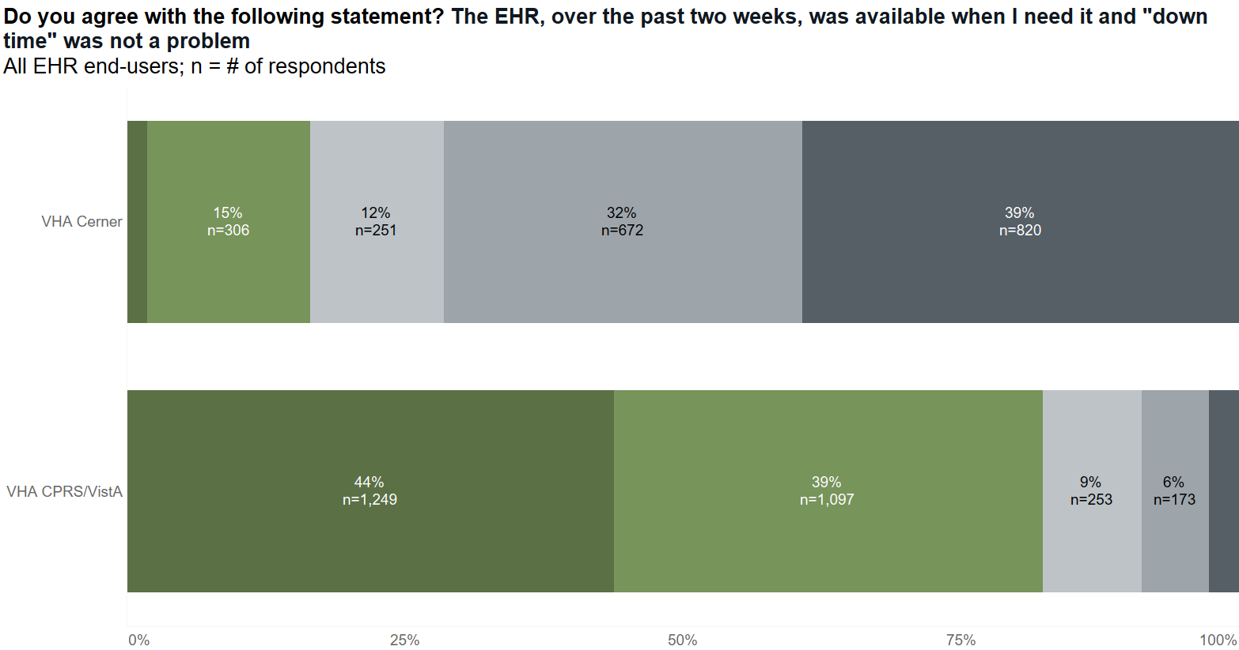
Notes:
% of Total Count of Over the past two weeks, the electronic health record was available when I needed it and “down time” was not a problem. along Over the past two weeks, the electronic health record was available when I needed it and “down time” was not a problem. Count of Over the past two weeks, the electronic health record was available when I needed it and “down time” was not a problem.
VHA Cerner Strongly disagree 39% 820
VHA Cerner Disagree 32% 672
VHA Cerner Indifferent 12% 251
VHA Cerner Agree 15% 306
VHA Cerner Strongly agree 2% 39
VHA CPRS/VistA Strongly disagree 3% 77
VHA CPRS/VistA Disagree 6% 173
VHA CPRS/VistA Indifferent 9% 253
VHA CPRS/VistA Agree 39% 1,097
VHA CPRS/VistA Strongly agree 44% 1,249

Slide 23
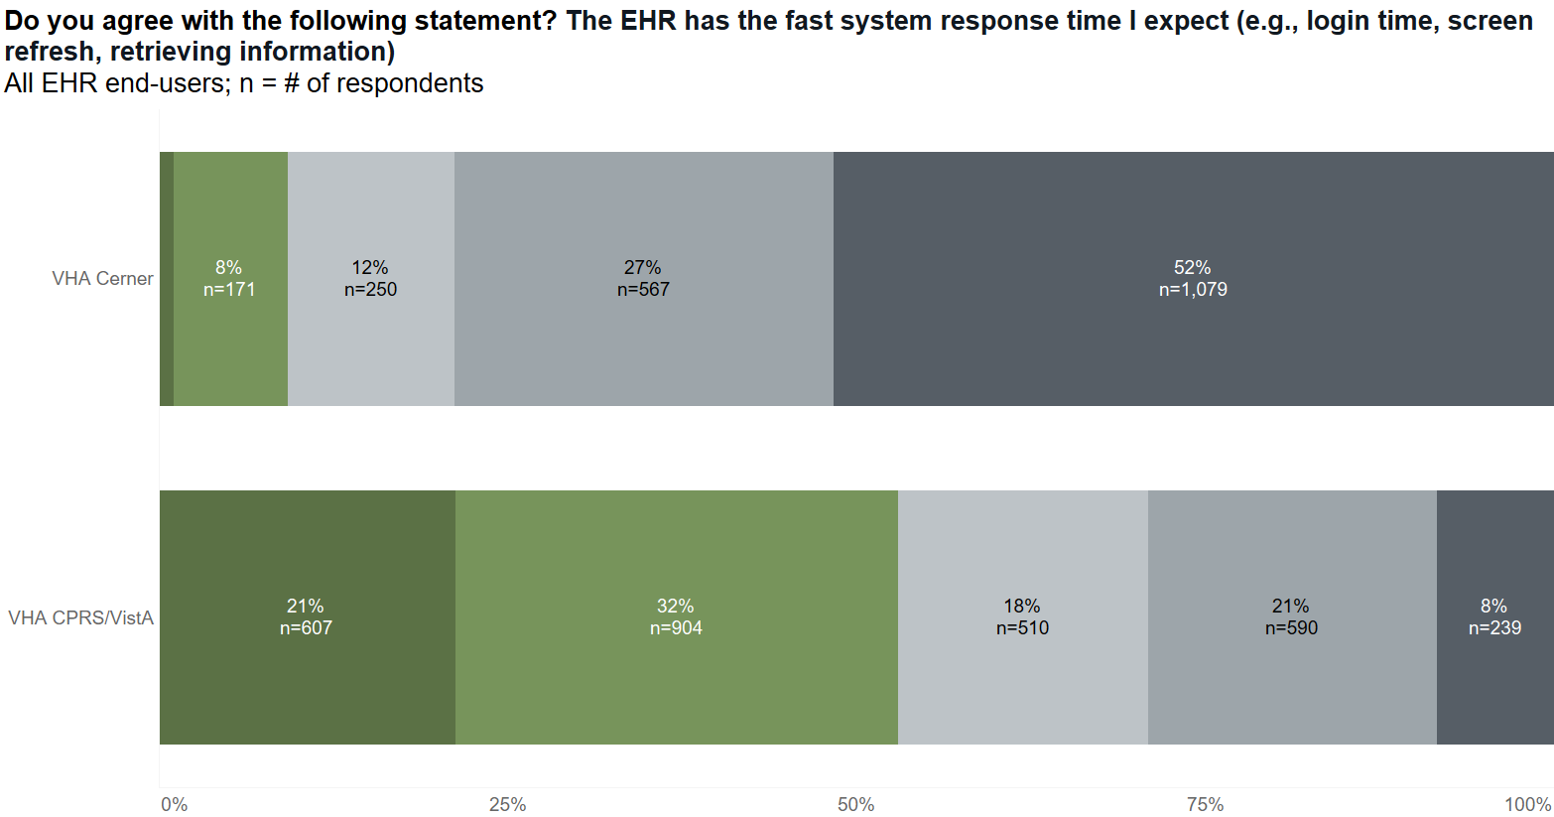
Notes:
% of Total Count of This electronic health record has the fast response time I expect (e.g., login time, screen refresh, retrieving information). along This electronic health record has the fast response time I expect (e.g., login time, screen refresh, retrieving information). Count of This electronic health record has the fast response time I expect (e.g., login time, screen refresh, retrieving information).
VHA Cerner Strongly disagree 52% 1,079
VHA Cerner Disagree 27% 567
VHA Cerner Indifferent 12% 250
VHA Cerner Agree 8% 171
VHA Cerner Strongly agree 1% 22
VHA CPRS/VistA Strongly disagree 8% 239
VHA CPRS/VistA Disagree 21% 590
VHA CPRS/VistA Indifferent 18% 510
VHA CPRS/VistA Agree 32% 904
VHA CPRS/VistA Strongly agree 21% 607

Slide 24
Potential action items from best practices
Adopt or create a technology that allows for real-time tracking of the infrastructure and interfaces that may affect the EHR
Adopt best practices for initial education of end-users
Teach to end-user workflows
Have 8–10 hours before go-live
A portion should be simulated or live
Reboot education for VISN 10 and VISN 20
Improve communication channels for changes and decision-making
Have a fast track for quick fixes
Ensure all end-users understand pathways
Always circle back to end-users when a request is sent

Slide 25
Speed of system and reliability are foundational to overall EHR experience
Arch Collaborative Findings (excludes VHA)
Notes:
https://klasresearch.com/archcollaborative/report/ehr-response-time-and-reliability/423

Slide 26
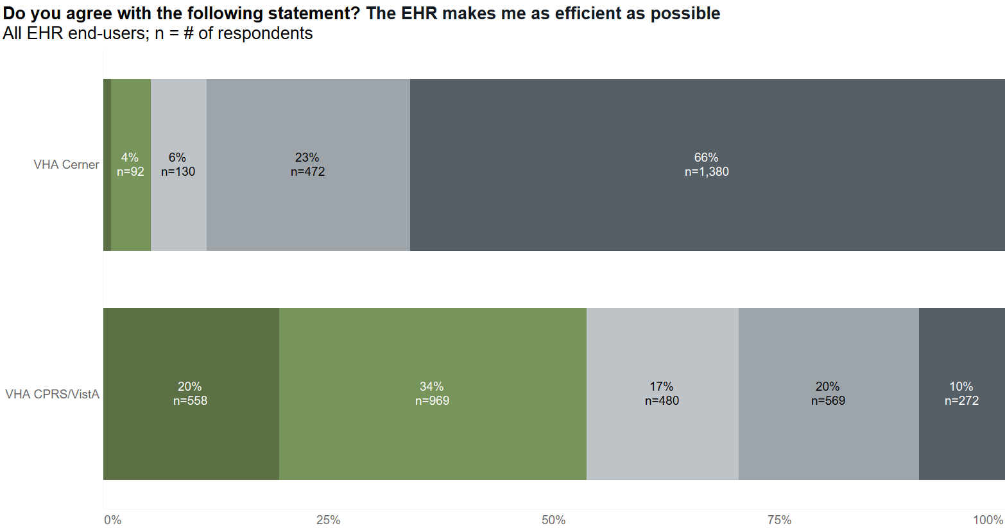
Notes:
% of Total Count of The electronic health record makes me as efficient as possible. along The electronic health record makes me as efficient as possible. Count of The electronic health record makes me as efficient as possible.
VHA Cerner Strongly disagree 66% 1,380
VHA Cerner Disagree 23% 472
VHA Cerner Indifferent 6% 130
VHA Cerner Agree 4% 92
VHA Cerner Strongly agree 1% 20
VHA CPRS/VistA Strongly disagree 10% 272
VHA CPRS/VistA Disagree 20% 569
VHA CPRS/VistA Indifferent 17% 480
VHA CPRS/VistA Agree 34% 969
VHA CPRS/VistA Strongly agree 20% 558

Slide 27
Speed of system is key to driving efficiency
“I complete similar tasks daily. Cerner takes twice as long as CPRS to complete the same tasks. Therefore, all day, I am trying to speed through triage calls, prescription processing, etc., to make up for the hours lost to CERNER inefficiency. Employee and veteran stress increases due to MY VA Health access and inefficiency. Veteran's attitude since CERNER more negative, increasing VA employee bullying by veterans to complete needed triage and healthcare duties.” – Nurse at Richland VA Clinic

Slide 28
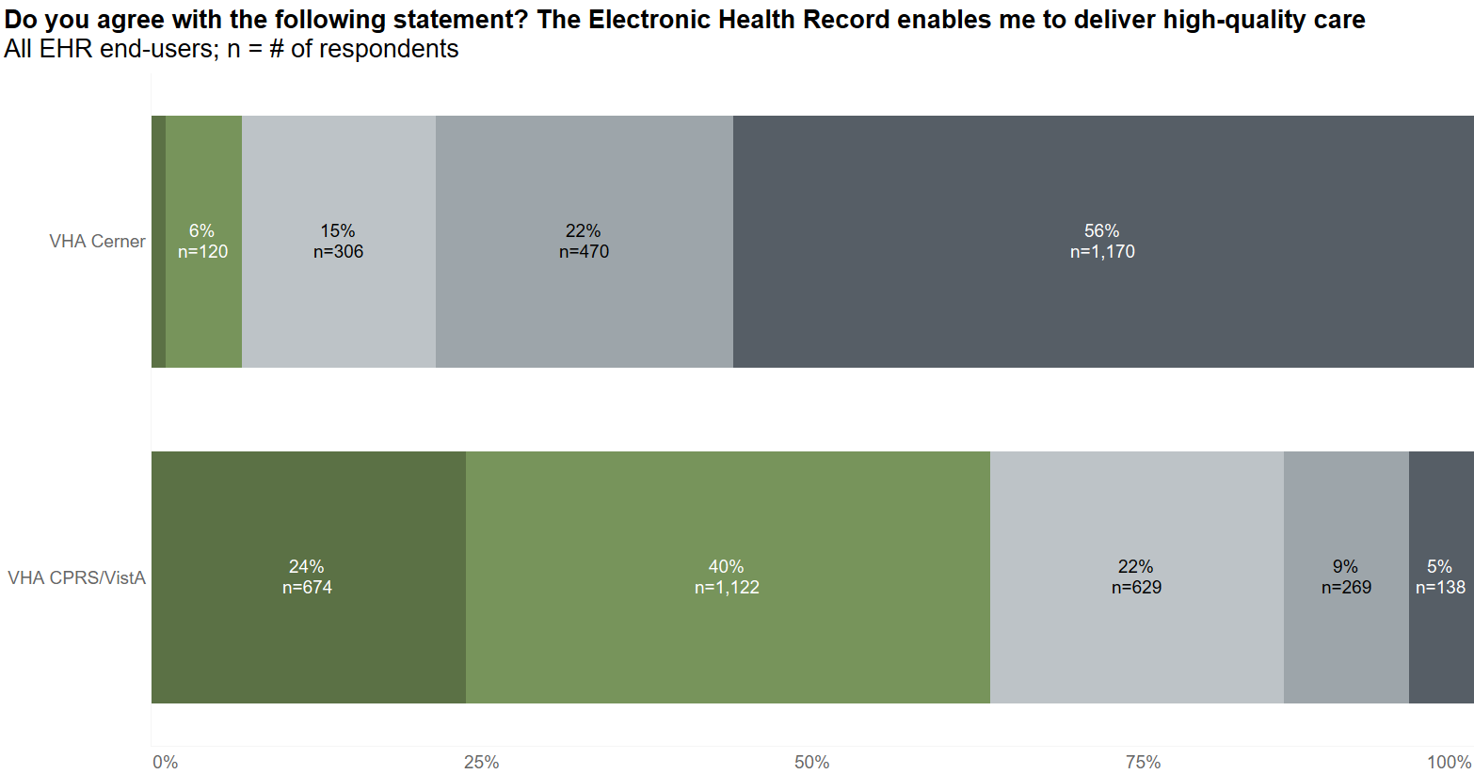
Notes:
% of Total Count of The electronic health record enables me to deliver high quality care. along The electronic health record enables me to deliver high quality care. Count of The electronic health record enables me to deliver high quality care.
VHA Cerner Strongly disagree 56% 1,170
VHA Cerner Disagree 22% 470
VHA Cerner Indifferent 15% 306
VHA Cerner Agree 6% 120
VHA Cerner Strongly agree 1% 24
VHA CPRS/VistA Strongly disagree 5% 138
VHA CPRS/VistA Disagree 9% 269
VHA CPRS/VistA Indifferent 22% 629
VHA CPRS/VistA Agree 40% 1,122
VHA CPRS/VistA Strongly agree 24% 674

Slide 29
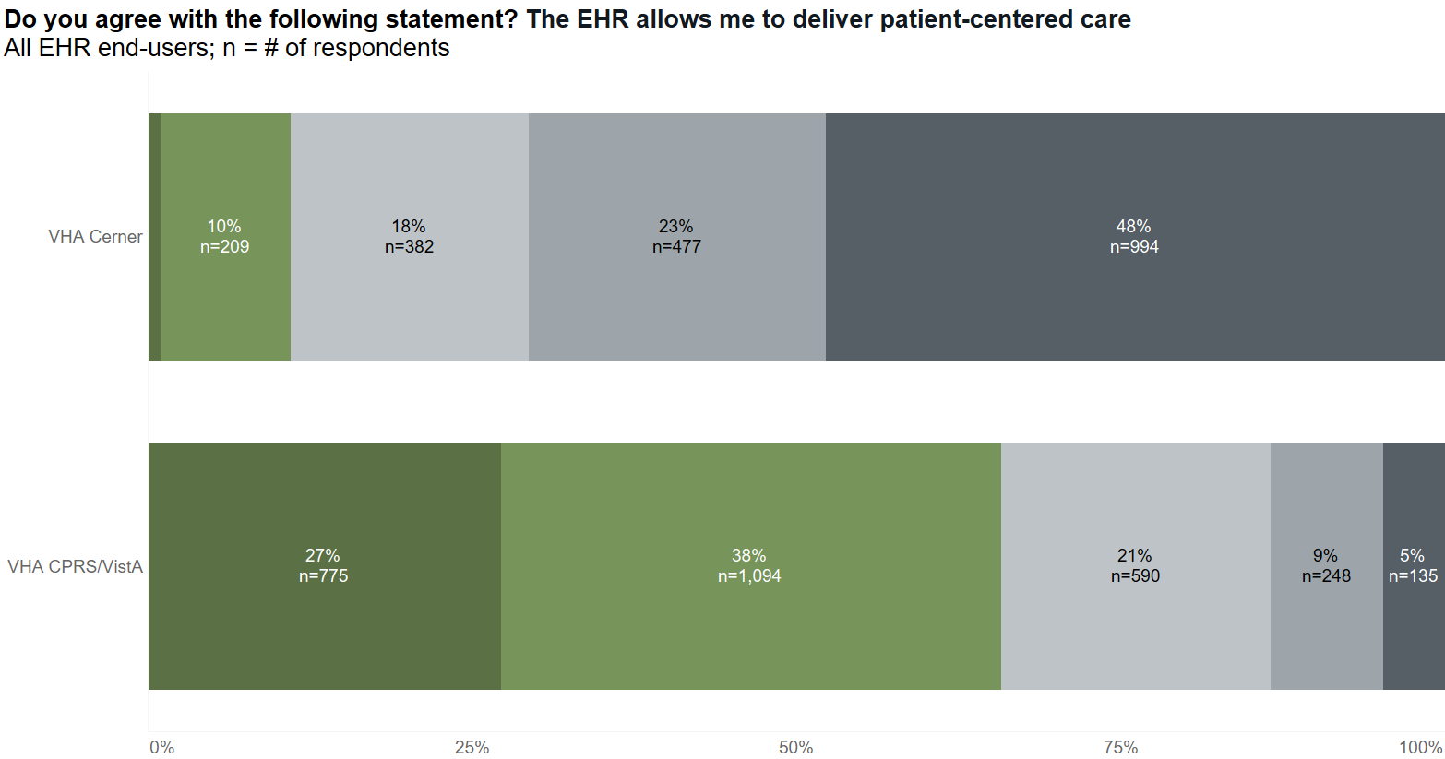
Notes:
% of Total Count of The electronic health record allows me to deliver patient-centered care. along The electronic health record allows me to deliver patient-centered care. Count of The electronic health record allows me to deliver patient-centered care.
VHA Cerner Strongly disagree 48% 994
VHA Cerner Disagree 23% 477
VHA Cerner Indifferent 18% 382
VHA Cerner Agree 10% 209
VHA Cerner Strongly agree 1% 20
VHA CPRS/VistA Strongly disagree 5% 135
VHA CPRS/VistA Disagree 9% 248
VHA CPRS/VistA Indifferent 21% 590
VHA CPRS/VistA Agree 38% 1,094
VHA CPRS/VistA Strongly agree 27% 775

Slide 30
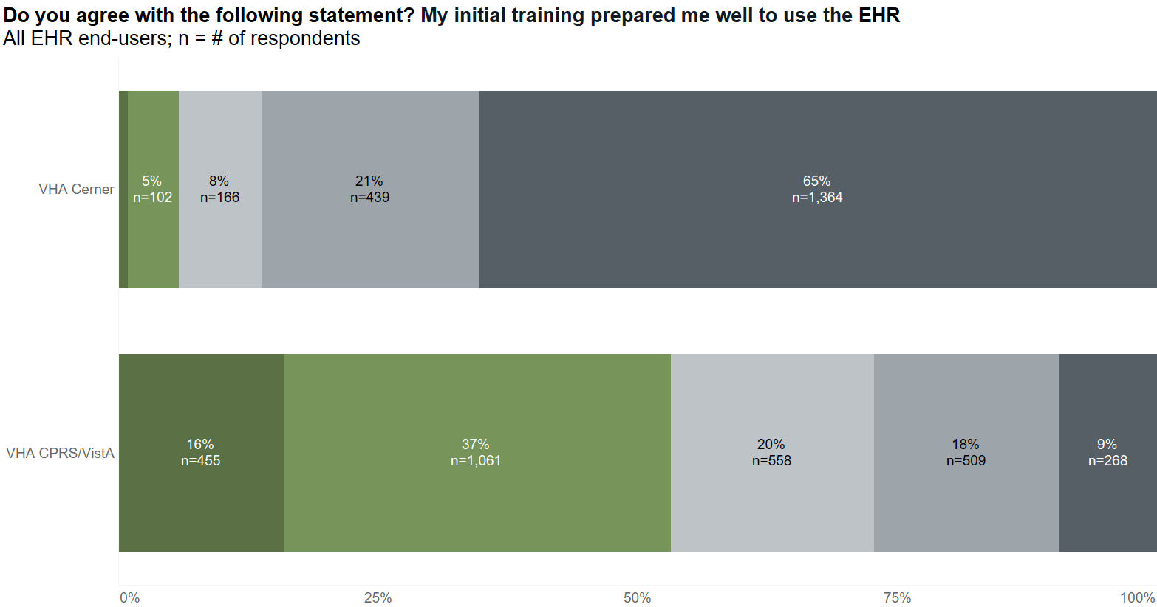
Notes:
% of Total Count of My initial training prepared me well to use this electronic health record. along My initial training prepared me well to use this electronic health record. Count of My initial training prepared me well to use this electronic health record.
VHA Cerner Strongly disagree 65% 1,364
VHA Cerner Disagree 21% 439
VHA Cerner Indifferent 8% 166
VHA Cerner Agree 5% 102
VHA Cerner Strongly agree 1% 20
VHA CPRS/VistA Strongly disagree 9% 268
VHA CPRS/VistA Disagree 18% 509
VHA CPRS/VistA Indifferent 20% 558
VHA CPRS/VistA Agree 37% 1,061
VHA CPRS/VistA Strongly agree 16% 455

Slide 31
Context of training timeframes
Site | Super User Training | End User Training
Columbus CSS | 2/10/20 – 2/28/20 | 7/13/20 – 8/5/20
Mann-Grandstaff | 8/10/20 – 8/21/20 | 8/24/20 – 10/23/20
 | No SUs for the CS2 release | 6/28/21 – 7/16/21
Walla Walla | 1/18/22 – 1/28/22 | 1/31/22 – 3/25/22
Columbus | 2/16/21 – 2/26/21 | 2/22/21 – 4/23/21
 | 2/28/22 – 3/11/22 | 3/14/22 – 4/29/22
Roseburg | 3/28/22 – 4/8/22 | 4/11/22 – 6/3/22
White City | 3/28/22 – 4/8/22 | 4/11/22 – 6/10/22
Boise | 4/11/22 – 4/22/22 | 4/25/22 – 6/24/22 7/14/22 – 7/20/22
Puget Sound | 6/10/22 – 6/27/22 | N/A

Slide 32
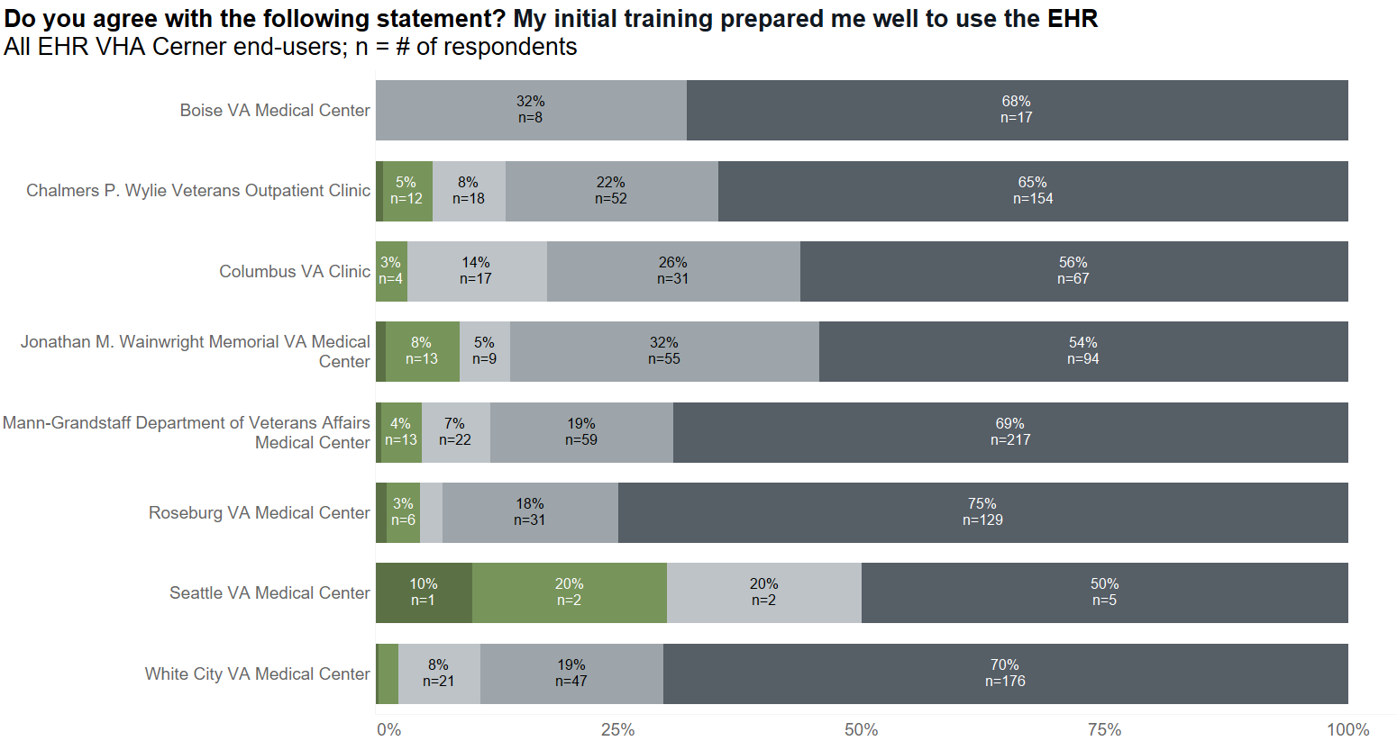
Notes:
% of Total Count of My initial training prepared me well to use this electronic health record. along My initial training prepared me well to use this electronic health record. Count of My initial training prepared me well to use this electronic health record.
Boise VA Medical Center Strongly disagree 68% 17.0
Boise VA Medical Center Disagree 32% 8.0
Chalmers P. Wylie Veterans Outpatient Clinic Strongly disagree 65% 154.0
Chalmers P. Wylie Veterans Outpatient Clinic Disagree 22% 52.0
Chalmers P. Wylie Veterans Outpatient Clinic Indifferent 8% 18.0
Chalmers P. Wylie Veterans Outpatient Clinic Agree 5% 12.0
Chalmers P. Wylie Veterans Outpatient Clinic Strongly agree 1% 2.0
Columbus VA Clinic Strongly disagree 56% 67.0
Columbus VA Clinic Disagree 26% 31.0
Columbus VA Clinic Indifferent 14% 17.0
Columbus VA Clinic Agree 3% 4.0
Jonathan M. Wainwright Memorial VA Medical Center Strongly disagree 54% 94.0
Jonathan M. Wainwright Memorial VA Medical Center Disagree 32% 55.0
Jonathan M. Wainwright Memorial VA Medical Center Indifferent 5% 9.0
Jonathan M. Wainwright Memorial VA Medical Center Agree 8% 13.0
Jonathan M. Wainwright Memorial VA Medical Center Strongly agree 1% 2.0
Mann-Grandstaff Department of Veterans Affairs Medical Center Strongly disagree 69% 217.0
Mann-Grandstaff Department of Veterans Affairs Medical Center Disagree 19% 59.0
Mann-Grandstaff Department of Veterans Affairs Medical Center Indifferent 7% 22.0
Mann-Grandstaff Department of Veterans Affairs Medical Center Agree 4% 13.0
Mann-Grandstaff Department of Veterans Affairs Medical Center Strongly agree 1% 2.0
Roseburg VA Medical Center Strongly disagree 75% 129.0
Roseburg VA Medical Center Disagree 18% 31.0
Roseburg VA Medical Center Indifferent 2% 4.0
Roseburg VA Medical Center Agree 3% 6.0
Roseburg VA Medical Center Strongly agree 1% 2.0
Seattle VA Medical Center Strongly disagree 50% 5.0
Seattle VA Medical Center Indifferent 20% 2.0
Seattle VA Medical Center Agree 20% 2.0
Seattle VA Medical Center Strongly agree 10% 1.0
White City VA Medical Center Strongly disagree 70% 176.0
White City VA Medical Center Disagree 19% 47.0
White City VA Medical Center Indifferent 8% 21.0
White City VA Medical Center Agree 2% 5.0
White City VA Medical Center Strongly agree 0% 1.0

Slide 33
“In Columbus, we had training twice. We provided feedback after the first set of training yet found no differences to the 2nd set of training over a year later. The trainers didn't know the specialty they were teaching and many of them also didn't know Cerner. None of the trainers were able to answer any questions that were outside of the script they were given. In the administrative scheduling courses, the students in the classes knew more than the trainers (since we in Columbus were already using CSS). It was shocking how little the trainers actually knew about Power Chart or Rev Cycle. We had our super-users in each of the classes our staff members were in and in many cases, the super-users (VA employees) took over the training courses.” – Physician at Chalmers P. Wylie Veterans Outpatient Clinic

Slide 34
Notes:
% of Total Count of My initial training prepared me well to use this electronic health record. along My initial training prepared me well to use this electronic health record. Count of My initial training prepared me well to use this electronic health record.
Boise VA Medical Center Strongly disagree 68% 17.0
Boise VA Medical Center Disagree 32% 8.0
Chalmers P. Wylie Veterans Outpatient Clinic Strongly disagree 65% 154.0
Chalmers P. Wylie Veterans Outpatient Clinic Disagree 22% 52.0
Chalmers P. Wylie Veterans Outpatient Clinic Indifferent 8% 18.0
Chalmers P. Wylie Veterans Outpatient Clinic Agree 5% 12.0
Chalmers P. Wylie Veterans Outpatient Clinic Strongly agree 1% 2.0
Columbus VA Clinic Strongly disagree 56% 67.0
Columbus VA Clinic Disagree 26% 31.0
Columbus VA Clinic Indifferent 14% 17.0
Columbus VA Clinic Agree 3% 4.0
Jonathan M. Wainwright Memorial VA Medical Center Strongly disagree 54% 94.0
Jonathan M. Wainwright Memorial VA Medical Center Disagree 32% 55.0
Jonathan M. Wainwright Memorial VA Medical Center Indifferent 5% 9.0
Jonathan M. Wainwright Memorial VA Medical Center Agree 8% 13.0
Jonathan M. Wainwright Memorial VA Medical Center Strongly agree 1% 2.0
Mann-Grandstaff Department of Veterans Affairs Medical Center Strongly disagree 69% 217.0
Mann-Grandstaff Department of Veterans Affairs Medical Center Disagree 19% 59.0
Mann-Grandstaff Department of Veterans Affairs Medical Center Indifferent 7% 22.0
Mann-Grandstaff Department of Veterans Affairs Medical Center Agree 4% 13.0
Mann-Grandstaff Department of Veterans Affairs Medical Center Strongly agree 1% 2.0
Roseburg VA Medical Center Strongly disagree 75% 129.0
Roseburg VA Medical Center Disagree 18% 31.0
Roseburg VA Medical Center Indifferent 2% 4.0
Roseburg VA Medical Center Agree 3% 6.0
Roseburg VA Medical Center Strongly agree 1% 2.0
Seattle VA Medical Center Strongly disagree 50% 5.0
Seattle VA Medical Center Indifferent 20% 2.0
Seattle VA Medical Center Agree 20% 2.0
Seattle VA Medical Center Strongly agree 10% 1.0
White City VA Medical Center Strongly disagree 70% 176.0
White City VA Medical Center Disagree 19% 47.0
White City VA Medical Center Indifferent 8% 21.0
White City VA Medical Center Agree 2% 5.0
White City VA Medical Center Strongly agree 0% 1.0

Slide 35
“Training was as good as any I've had. this system is my 6th EHR to learn (CHCS, AHLTA, ExitCare, EPIC, CPRS, CERNER) - all have had their rough edges, but CERNER has been the worst in needing reworks and system failures. Usefully training providers really only occurs after the initial system log-on training when we learn by doing and asking each other what works and what doesn't, that isn't unique to CERNER. Trainers are rarely adequately prepared to help providers as much as actively practicing providers. Information overload is now the baseline for Cerner as we receive "updates" every week or more often on changes that may or may not apply to my daily work. I’ve quit looking and wait until something affects my daily flow before I interrupt my busy workday to research the next work-around. Not efficient, but the most common survival tactic to get me and my colleagues through to retirement.” – Physician at Mann-Grandstaff Department of Veterans Affairs Medical Center

Slide 36
Notes:
% of Total Count of My initial training prepared me well to use this electronic health record. along My initial training prepared me well to use this electronic health record. Count of My initial training prepared me well to use this electronic health record.
Boise VA Medical Center Strongly disagree 68% 17.0
Boise VA Medical Center Disagree 32% 8.0
Chalmers P. Wylie Veterans Outpatient Clinic Strongly disagree 65% 154.0
Chalmers P. Wylie Veterans Outpatient Clinic Disagree 22% 52.0
Chalmers P. Wylie Veterans Outpatient Clinic Indifferent 8% 18.0
Chalmers P. Wylie Veterans Outpatient Clinic Agree 5% 12.0
Chalmers P. Wylie Veterans Outpatient Clinic Strongly agree 1% 2.0
Columbus VA Clinic Strongly disagree 56% 67.0
Columbus VA Clinic Disagree 26% 31.0
Columbus VA Clinic Indifferent 14% 17.0
Columbus VA Clinic Agree 3% 4.0
Jonathan M. Wainwright Memorial VA Medical Center Strongly disagree 54% 94.0
Jonathan M. Wainwright Memorial VA Medical Center Disagree 32% 55.0
Jonathan M. Wainwright Memorial VA Medical Center Indifferent 5% 9.0
Jonathan M. Wainwright Memorial VA Medical Center Agree 8% 13.0
Jonathan M. Wainwright Memorial VA Medical Center Strongly agree 1% 2.0
Mann-Grandstaff Department of Veterans Affairs Medical Center Strongly disagree 69% 217.0
Mann-Grandstaff Department of Veterans Affairs Medical Center Disagree 19% 59.0
Mann-Grandstaff Department of Veterans Affairs Medical Center Indifferent 7% 22.0
Mann-Grandstaff Department of Veterans Affairs Medical Center Agree 4% 13.0
Mann-Grandstaff Department of Veterans Affairs Medical Center Strongly agree 1% 2.0
Roseburg VA Medical Center Strongly disagree 75% 129.0
Roseburg VA Medical Center Disagree 18% 31.0
Roseburg VA Medical Center Indifferent 2% 4.0
Roseburg VA Medical Center Agree 3% 6.0
Roseburg VA Medical Center Strongly agree 1% 2.0
Seattle VA Medical Center Strongly disagree 50% 5.0
Seattle VA Medical Center Indifferent 20% 2.0
Seattle VA Medical Center Agree 20% 2.0
Seattle VA Medical Center Strongly agree 10% 1.0
White City VA Medical Center Strongly disagree 70% 176.0
White City VA Medical Center Disagree 19% 47.0
White City VA Medical Center Indifferent 8% 21.0
White City VA Medical Center Agree 2% 5.0
White City VA Medical Center Strongly agree 0% 1.0

Slide 37
“After my Cerner training, I went back to trainer for quick help on areas he taught me. He could not answer my questions. It turns out all his education was scripted, and he really was not a user. We desperately need an immediately available help desk to help us with immediate issues. this service when it identifies a programming issue should then put in a repair ticket” – Physician at Jonathan M. Wainwright Memorial VA Medical Center

Slide 38
Notes:
% of Total Count of My initial training prepared me well to use this electronic health record. along My initial training prepared me well to use this electronic health record. Count of My initial training prepared me well to use this electronic health record.
Boise VA Medical Center Strongly disagree 68% 17.0
Boise VA Medical Center Disagree 32% 8.0
Chalmers P. Wylie Veterans Outpatient Clinic Strongly disagree 65% 154.0
Chalmers P. Wylie Veterans Outpatient Clinic Disagree 22% 52.0
Chalmers P. Wylie Veterans Outpatient Clinic Indifferent 8% 18.0
Chalmers P. Wylie Veterans Outpatient Clinic Agree 5% 12.0
Chalmers P. Wylie Veterans Outpatient Clinic Strongly agree 1% 2.0
Columbus VA Clinic Strongly disagree 56% 67.0
Columbus VA Clinic Disagree 26% 31.0
Columbus VA Clinic Indifferent 14% 17.0
Columbus VA Clinic Agree 3% 4.0
Jonathan M. Wainwright Memorial VA Medical Center Strongly disagree 54% 94.0
Jonathan M. Wainwright Memorial VA Medical Center Disagree 32% 55.0
Jonathan M. Wainwright Memorial VA Medical Center Indifferent 5% 9.0
Jonathan M. Wainwright Memorial VA Medical Center Agree 8% 13.0
Jonathan M. Wainwright Memorial VA Medical Center Strongly agree 1% 2.0
Mann-Grandstaff Department of Veterans Affairs Medical Center Strongly disagree 69% 217.0
Mann-Grandstaff Department of Veterans Affairs Medical Center Disagree 19% 59.0
Mann-Grandstaff Department of Veterans Affairs Medical Center Indifferent 7% 22.0
Mann-Grandstaff Department of Veterans Affairs Medical Center Agree 4% 13.0
Mann-Grandstaff Department of Veterans Affairs Medical Center Strongly agree 1% 2.0
Roseburg VA Medical Center Strongly disagree 75% 129.0
Roseburg VA Medical Center Disagree 18% 31.0
Roseburg VA Medical Center Indifferent 2% 4.0
Roseburg VA Medical Center Agree 3% 6.0
Roseburg VA Medical Center Strongly agree 1% 2.0
Seattle VA Medical Center Strongly disagree 50% 5.0
Seattle VA Medical Center Indifferent 20% 2.0
Seattle VA Medical Center Agree 20% 2.0
Seattle VA Medical Center Strongly agree 10% 1.0
White City VA Medical Center Strongly disagree 70% 176.0
White City VA Medical Center Disagree 19% 47.0
White City VA Medical Center Indifferent 8% 21.0
White City VA Medical Center Agree 2% 5.0
White City VA Medical Center Strongly agree 0% 1.0

Slide 39
“The info from the NESSU providers has been very useful. The training from Cerner was not. The online training was a lot of wasted time on processes not applicable to my role. The in-person trainers didn't understand our roles. It was too generalized and the person I had was pretty condescending to the group overall, could not explain processes for many of the questions about how our current process would translate into Cerner, and took too much time on analogies that were meaningless (signing out via the x in the corner vs the exit button being like coming into a room on fire to retrieve your things via a window (?) when all she had to say was things might not save correctly if you don't log out via the exit button).” – Physician at Roseburg VA Medical Center

Slide 40
Notes:
% of Total Count of My initial training prepared me well to use this electronic health record. along My initial training prepared me well to use this electronic health record. Count of My initial training prepared me well to use this electronic health record.
Boise VA Medical Center Strongly disagree 68% 17.0
Boise VA Medical Center Disagree 32% 8.0
Chalmers P. Wylie Veterans Outpatient Clinic Strongly disagree 65% 154.0
Chalmers P. Wylie Veterans Outpatient Clinic Disagree 22% 52.0
Chalmers P. Wylie Veterans Outpatient Clinic Indifferent 8% 18.0
Chalmers P. Wylie Veterans Outpatient Clinic Agree 5% 12.0
Chalmers P. Wylie Veterans Outpatient Clinic Strongly agree 1% 2.0
Columbus VA Clinic Strongly disagree 56% 67.0
Columbus VA Clinic Disagree 26% 31.0
Columbus VA Clinic Indifferent 14% 17.0
Columbus VA Clinic Agree 3% 4.0
Jonathan M. Wainwright Memorial VA Medical Center Strongly disagree 54% 94.0
Jonathan M. Wainwright Memorial VA Medical Center Disagree 32% 55.0
Jonathan M. Wainwright Memorial VA Medical Center Indifferent 5% 9.0
Jonathan M. Wainwright Memorial VA Medical Center Agree 8% 13.0
Jonathan M. Wainwright Memorial VA Medical Center Strongly agree 1% 2.0
Mann-Grandstaff Department of Veterans Affairs Medical Center Strongly disagree 69% 217.0
Mann-Grandstaff Department of Veterans Affairs Medical Center Disagree 19% 59.0
Mann-Grandstaff Department of Veterans Affairs Medical Center Indifferent 7% 22.0
Mann-Grandstaff Department of Veterans Affairs Medical Center Agree 4% 13.0
Mann-Grandstaff Department of Veterans Affairs Medical Center Strongly agree 1% 2.0
Roseburg VA Medical Center Strongly disagree 75% 129.0
Roseburg VA Medical Center Disagree 18% 31.0
Roseburg VA Medical Center Indifferent 2% 4.0
Roseburg VA Medical Center Agree 3% 6.0
Roseburg VA Medical Center Strongly agree 1% 2.0
Seattle VA Medical Center Strongly disagree 50% 5.0
Seattle VA Medical Center Indifferent 20% 2.0
Seattle VA Medical Center Agree 20% 2.0
Seattle VA Medical Center Strongly agree 10% 1.0
White City VA Medical Center Strongly disagree 70% 176.0
White City VA Medical Center Disagree 19% 47.0
White City VA Medical Center Indifferent 8% 21.0
White City VA Medical Center Agree 2% 5.0
White City VA Medical Center Strongly agree 0% 1.0

Slide 41
“It was horrendous. Abysmal. On the day I went to the Level 300s, the proctor thought that this was a hospital (It is NOT) and started the morning by saying "today we will start by teaching you how to do inpatient admission orders". We were all incredulous that no one at Cerner bothered to learn their target audience. So, 2 of the 4 hours was WASTED in trying to find the proper teaching documents. Since only 4 hours were blocked for this activity, and we were left with 2, it was basically worthless. Then at the 400 level classes, the "pick your favorites" fair, there was only one proctor and because she had to attend to people individually because we couldn't tell what she was talking about, the "favorites fair" didn't really actually happen. Then they let us sign up in TMS for another session, but the links did not work and we were told "sorry that's a national thing, too bad". By the time they got this working, it was too late to sign up. So, I felt completely unprepared for Go-Live day. And even then, the Cerner people needed to be with everyone at the elbow so I only got help a handful of times. It was the most horrible preparation I have every experienced.” – Physician at White City VA Medical Center

Slide 42
Notes:
% of Total Count of My initial training prepared me well to use this electronic health record. along My initial training prepared me well to use this electronic health record. Count of My initial training prepared me well to use this electronic health record.
Boise VA Medical Center Strongly disagree 68% 17.0
Boise VA Medical Center Disagree 32% 8.0
Chalmers P. Wylie Veterans Outpatient Clinic Strongly disagree 65% 154.0
Chalmers P. Wylie Veterans Outpatient Clinic Disagree 22% 52.0
Chalmers P. Wylie Veterans Outpatient Clinic Indifferent 8% 18.0
Chalmers P. Wylie Veterans Outpatient Clinic Agree 5% 12.0
Chalmers P. Wylie Veterans Outpatient Clinic Strongly agree 1% 2.0
Columbus VA Clinic Strongly disagree 56% 67.0
Columbus VA Clinic Disagree 26% 31.0
Columbus VA Clinic Indifferent 14% 17.0
Columbus VA Clinic Agree 3% 4.0
Jonathan M. Wainwright Memorial VA Medical Center Strongly disagree 54% 94.0
Jonathan M. Wainwright Memorial VA Medical Center Disagree 32% 55.0
Jonathan M. Wainwright Memorial VA Medical Center Indifferent 5% 9.0
Jonathan M. Wainwright Memorial VA Medical Center Agree 8% 13.0
Jonathan M. Wainwright Memorial VA Medical Center Strongly agree 1% 2.0
Mann-Grandstaff Department of Veterans Affairs Medical Center Strongly disagree 69% 217.0
Mann-Grandstaff Department of Veterans Affairs Medical Center Disagree 19% 59.0
Mann-Grandstaff Department of Veterans Affairs Medical Center Indifferent 7% 22.0
Mann-Grandstaff Department of Veterans Affairs Medical Center Agree 4% 13.0
Mann-Grandstaff Department of Veterans Affairs Medical Center Strongly agree 1% 2.0
Roseburg VA Medical Center Strongly disagree 75% 129.0
Roseburg VA Medical Center Disagree 18% 31.0
Roseburg VA Medical Center Indifferent 2% 4.0
Roseburg VA Medical Center Agree 3% 6.0
Roseburg VA Medical Center Strongly agree 1% 2.0
Seattle VA Medical Center Strongly disagree 50% 5.0
Seattle VA Medical Center Indifferent 20% 2.0
Seattle VA Medical Center Agree 20% 2.0
Seattle VA Medical Center Strongly agree 10% 1.0
White City VA Medical Center Strongly disagree 70% 176.0
White City VA Medical Center Disagree 19% 47.0
White City VA Medical Center Indifferent 8% 21.0
White City VA Medical Center Agree 2% 5.0
White City VA Medical Center Strongly agree 0% 1.0

Slide 43
“I used Cerner at SARMC in Boise and went through their training. The amount of additional work being required by Cerner at VA was significantly more and much less efficient. Using Cerner at SARMC was very straight forward, kept things simple, & allowed me to be much more efficient. The Cerner training at VA was not good other than sessions with a physician on Fridays in June and the lunch sessions, rest of training was not good. Does not make sense to do trainings with people from all different backgrounds as training would then be focused on one particular group from amongst the larger group. Better to do physicians w/ physicians. Nursing w/ nursing. SW w/ SW, etc. If training is wanted for a particular day, then that provider's patients for that day should be rescheduled automatically and ideally communicated to the veterans by telephone so that they are not driving in needlessly as many would tell me the text messages they were receiving did not say appt was cancelled. Not enough VISN support for Boise VA outpatient psychiatry consults and f/u's during ramp down/ramp up or CAL CBOC […]” – Physician at Boise VA Medical Center

Slide 44
Potential action items from best practices
Adopt or create a technology that allows for real-time tracking of the infrastructure and interfaces that may affect the EHR
Adopt best practices for initial education of end-users
Teach to end-user workflows
Have 8–10 hours before go-live
A portion should be simulated or live
Reboot education for VISN 10 and VISN 20
Improve communication channels for changes and decision-making
Have a fast track for quick fixes
Ensure all end-users understand pathways
Always circle back to end-users when a request is sent

Slide 45
Initial education is vital to overall experience to EHR
Arch Collaborative Findings (excludes VHA)
Notes:
https://klasresearch.com/archcollaborative/report/clinician-training-2021-update/379

Slide 46
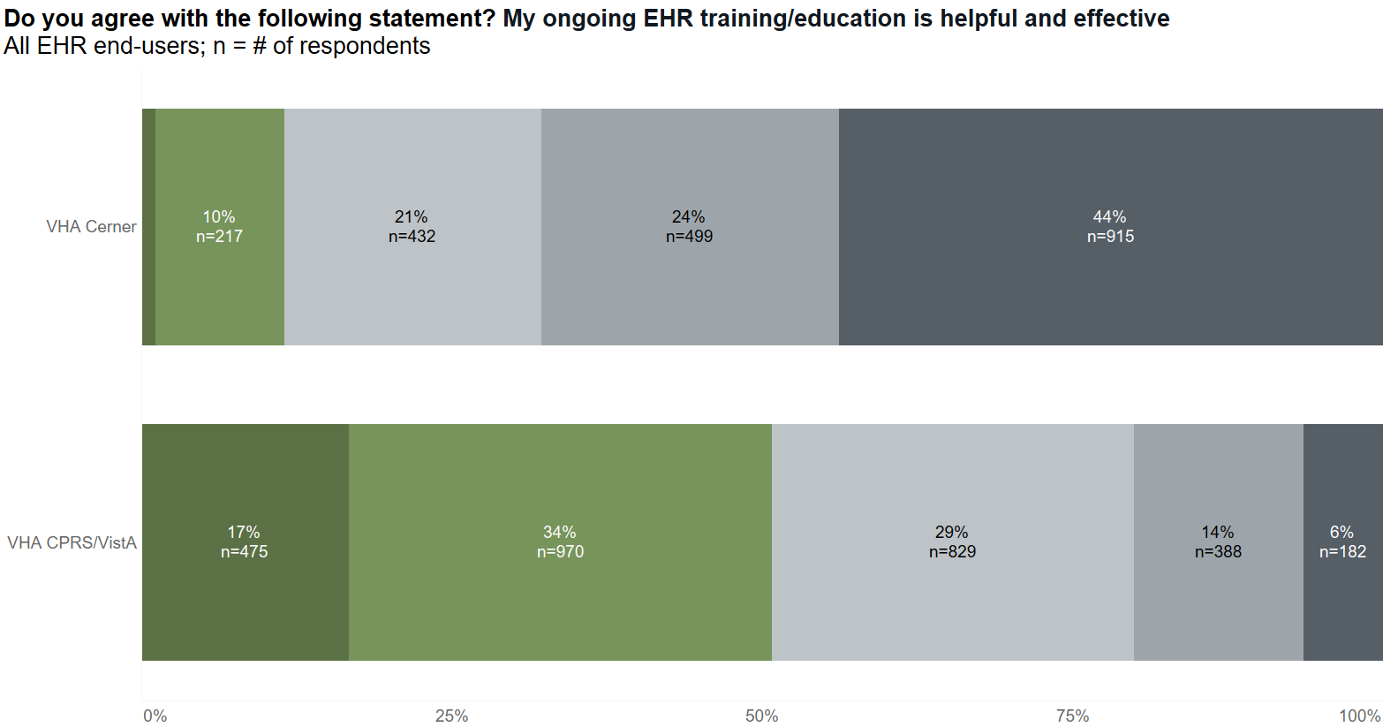
Notes:
% of Total Count of My ongoing electronic health record training/education is helpful and effective. along My ongoing electronic health record training/education is helpful and effective. Count of My ongoing electronic health record training/education is helpful and effective.
VHA Cerner Strongly disagree 44% 915.0
VHA Cerner Disagree 24% 499.0
VHA Cerner Indifferent 21% 432.0
VHA Cerner Agree 10% 217.0
VHA Cerner Strongly agree 1% 24.0
VHA CPRS/VistA Strongly disagree 6% 182.0
VHA CPRS/VistA Disagree 14% 388.0
VHA CPRS/VistA Indifferent 29% 829.0
VHA CPRS/VistA Agree 34% 970.0
VHA CPRS/VistA Strongly agree 17% 475.0

Slide 47
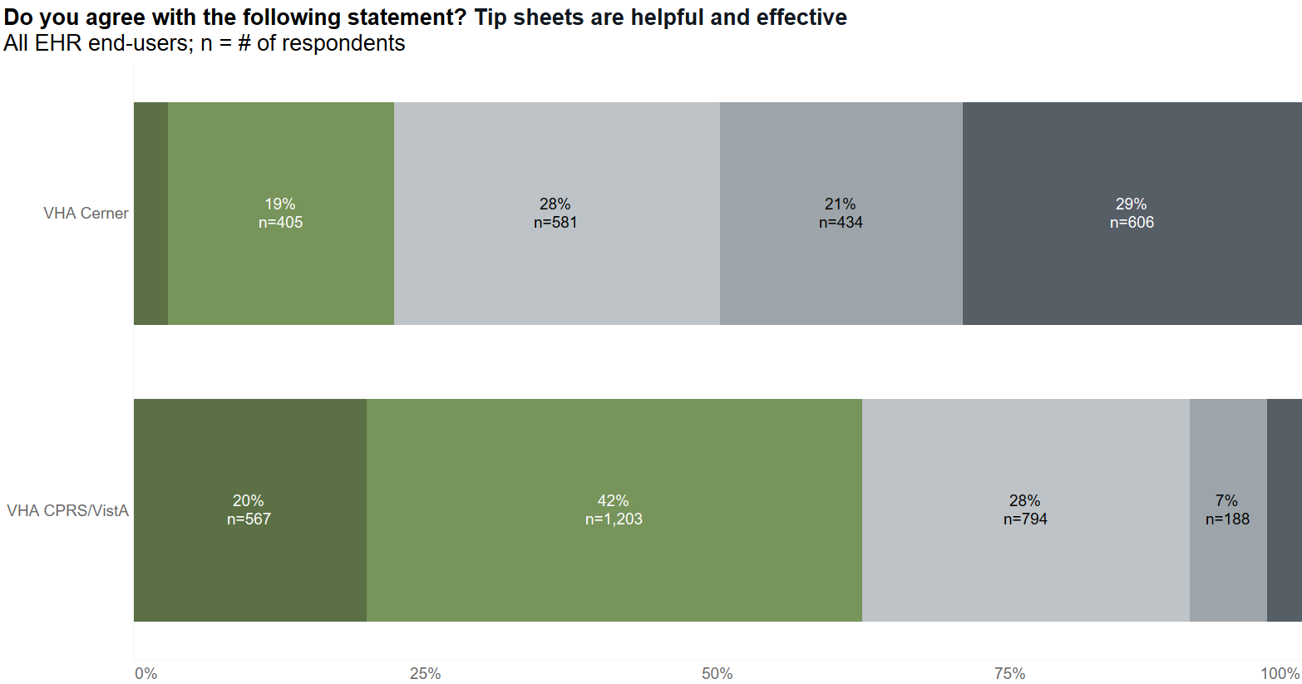
Notes:
% of Total Count of Tip Sheets Helpful and Effective along Tip Sheets Helpful and Effective Count of Tip Sheets Helpful and Effective
VHA Cerner Strongly disagree 29% 606
VHA Cerner Disagree 21% 434
VHA Cerner Indifferent 28% 581
VHA Cerner Agree 19% 405
VHA Cerner Strongly agree 3% 62
VHA CPRS/VistA Strongly disagree 3% 85
VHA CPRS/VistA Disagree 7% 188
VHA CPRS/VistA Indifferent 28% 794
VHA CPRS/VistA Agree 42% 1,203
VHA CPRS/VistA Strongly agree 20% 567

Slide 48
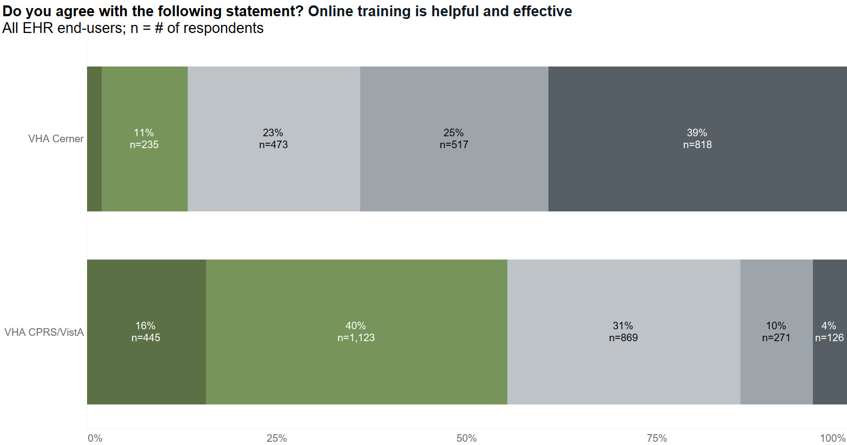
Notes:
% of Total Count of Online Training is Helpful along Online Training is Helpful Count of Online Training is Helpful
VHA Cerner Strongly disagree 39% 818
VHA Cerner Disagree 25% 517
VHA Cerner Indifferent 23% 473
VHA Cerner Agree 11% 235
VHA Cerner Strongly agree 2% 42
VHA CPRS/VistA Strongly disagree 4% 126
VHA CPRS/VistA Disagree 10% 271
VHA CPRS/VistA Indifferent 31% 869
VHA CPRS/VistA Agree 40% 1,123
VHA CPRS/VistA Strongly agree 16% 445

Slide 49
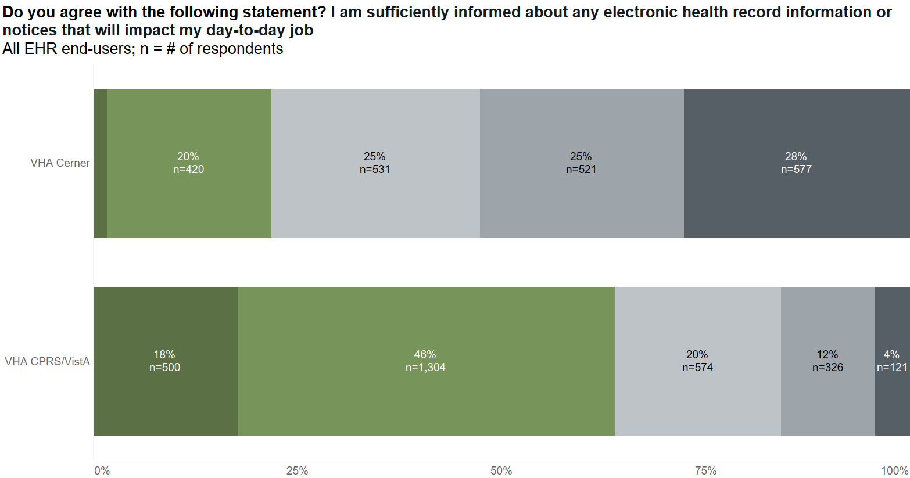
Notes:
% of Total Count of I am sufficiently informed about any electronic health record information or notices that will impact my day-to-day job. along I am sufficiently informed about any electronic health record information or notices that will impact my day-to-day job. Count of I am sufficiently informed about any electronic health record information or notices that will impact my day-to-day job.
VHA Cerner Strongly disagree 28% 577
VHA Cerner Disagree 25% 521
VHA Cerner Indifferent 25% 531
VHA Cerner Agree 20% 420
VHA Cerner Strongly agree 2% 36
VHA CPRS/VistA Strongly disagree 4% 121
VHA CPRS/VistA Disagree 12% 326
VHA CPRS/VistA Indifferent 20% 574
VHA CPRS/VistA Agree 46% 1,304
VHA CPRS/VistA Strongly agree 18% 500

Slide 50
Potential action items from best practices
Adopt or create a technology that allows for real-time tracking of the infrastructure and interfaces that may affect the EHR
Adopt best practices for initial education of end-users
Teach to end-user workflows
Have 8–10 hours before go-live
A portion should be simulated or live
Reboot education for VISN 10 and VISN 20
Improve communication channels for changes and decision-making
Have a fast track for quick fixes
Ensure all end-users understand pathways
Always circle back to end-users when a request is sent

Slide 51
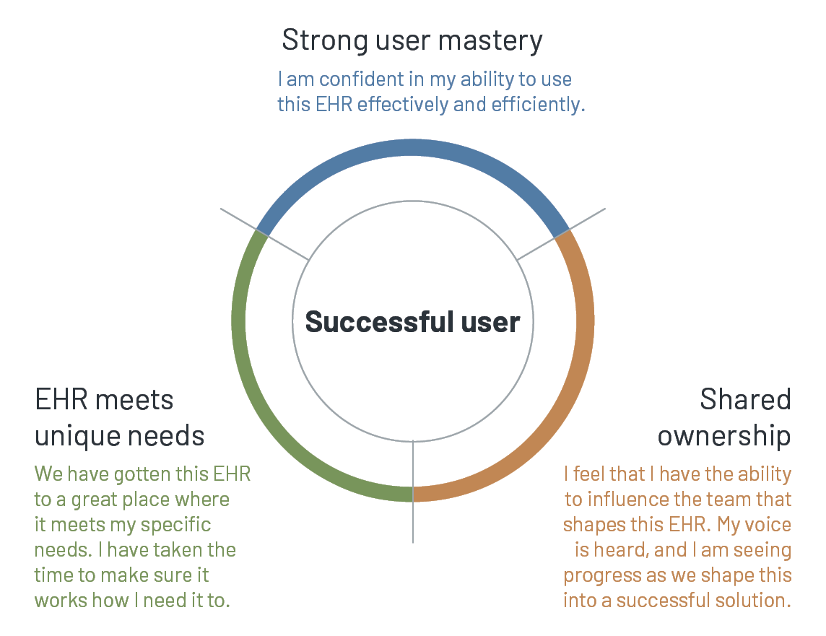
What Makes a Successful Clinical EHR User?

Slide 52
EHR House of Success
EHR Satisfaction
Shared Ownership
Education/Training
Meeting Unique User Needs
Pillars of Success
Reliability
Speed
Integration

Slide 53
Potential action items from best practices
Adopt or create a technology that allows for real-time tracking of the infrastructure and interfaces that may affect the EHR
Adopt best practices for initial education of end-users
Teach to end-user workflows
Have 8–10 hours before go-live
A portion should be simulated or live
Reboot education for VISN 10 and VISN 20
Improve communication channels for changes and decision-making
Have a fast track for quick fixes
Ensure all end-users understand pathways
Always circle back to end-users when a request is sent

Slide 54
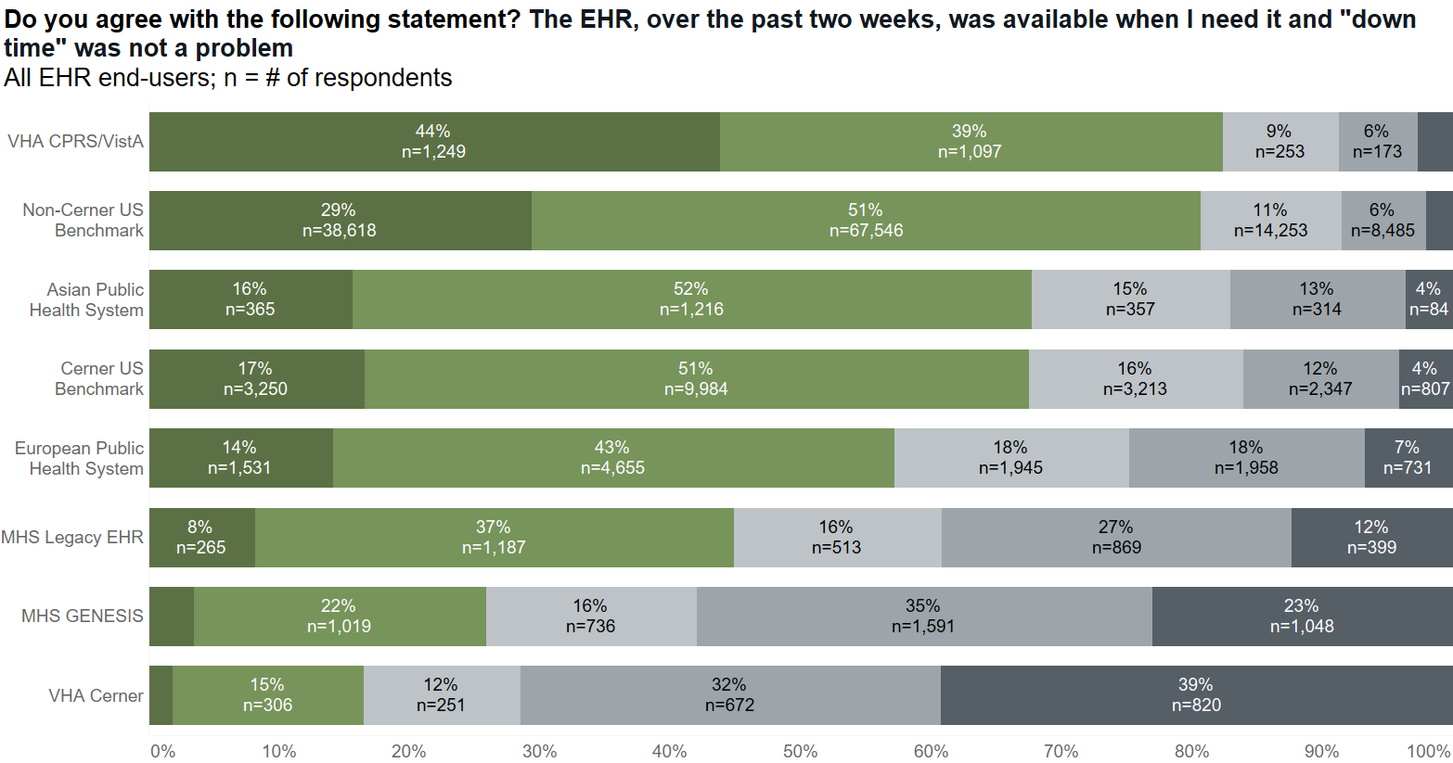
Notes:
COUNT([Satisfaction Reliability Response]) / TOTAL(COUNT([Sat... along Satisfaction Reliability Response COUNT([Satisfaction Reliability Response]) / TOTAL(COUNT([Sat... along Satisfaction Reliability Response Count of Satisfaction Reliability Response
VHA CPRS/VistA 0% 0% 0
VHA CPRS/VistA Strongly disagree 3% 3% 77
VHA CPRS/VistA Disagree 6% 6% 173
VHA CPRS/VistA Indifferent 9% 9% 253
VHA CPRS/VistA Agree 39% 39% 1,097
VHA CPRS/VistA Strongly agree 44% 44% 1,249
Non-Cerner US Benchmark 0% 0% 0
Non-Cerner US Benchmark Strongly disagree 2% 2% 2,724
Non-Cerner US Benchmark Disagree 6% 6% 8,485
Non-Cerner US Benchmark Indifferent 11% 11% 14,253
Non-Cerner US Benchmark Agree 51% 51% 67,546
Non-Cerner US Benchmark Strongly agree 29% 29% 38,618
Asian Public Health System 0% 0% 0
Asian Public Health System Strongly disagree 4% 4% 84
Asian Public Health System Disagree 13% 13% 314
Asian Public Health System Indifferent 15% 15% 357
Asian Public Health System Agree 52% 52% 1,216
Asian Public Health System Strongly agree 16% 16% 365
Cerner US Benchmark 0% 0% 0
Cerner US Benchmark Strongly disagree 4% 4% 807
Cerner US Benchmark Disagree 12% 12% 2,347
Cerner US Benchmark Indifferent 16% 16% 3,213
Cerner US Benchmark Agree 51% 51% 9,984
Cerner US Benchmark Strongly agree 17% 17% 3,250
European Public Health System 0% 0% 0
European Public Health System Strongly disagree 7% 7% 731
European Public Health System Disagree 18% 18% 1,958
European Public Health System Indifferent 18% 18% 1,945
European Public Health System Agree 43% 43% 4,655
European Public Health System Strongly agree 14% 14% 1,531
MHS Legacy EHR 0% 0% 0
MHS Legacy EHR Strongly disagree 12% 12% 399
MHS Legacy EHR Disagree 27% 27% 869
MHS Legacy EHR Indifferent 16% 16% 513
MHS Legacy EHR Agree 37% 37% 1,187
MHS Legacy EHR Strongly agree 8% 8% 265
MHS GENESIS Strongly Disagree 23% 23% 1,048
MHS GENESIS Disagree 35% 35% 1,591
MHS GENESIS Indifferent 16% 16% 736
MHS GENESIS Agree 22% 22% 1,019
MHS GENESIS Strongly agree 3% 3% 158
VHA Cerner 0% 0% 0
VHA Cerner Strongly disagree 39% 39% 820
VHA Cerner Disagree 32% 32% 672
VHA Cerner Indifferent 12% 12% 251
VHA Cerner Agree 15% 15% 306
VHA Cerner Strongly agree 2% 2% 39

Slide 55




Arch Collaborative 2022 Provider Workshop
“The EHR experience begins with the lowly computer mouse.”
Dr. Emily Webber, MD, FAAP, FAMIA
CMIO for Indiana University Health and Riley Children’s Health

Slide 56
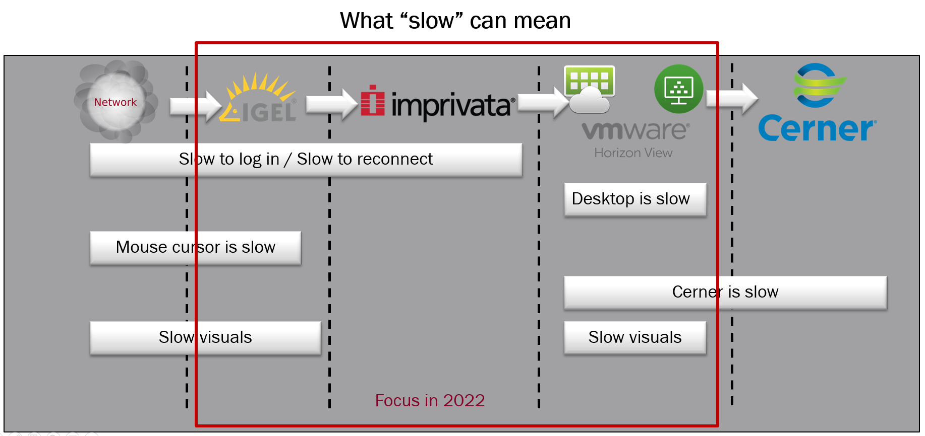
System reliability and performance
Arch Collaborative 2022 Provider Workshop

Slide 57
Case Study: Intermountain Healthcare and Goliath Technologies
Outcomes
26% increase in agreement that the EHR is reliable
22% increase in agreement that the EHR has fast system response time
What Intermountain Healthcare and Goliath Technologies Did
Spent 18 months rolling out solution before go-live
Had real-time monitoring of reliability and response time metrics
Identified where the system wasn’t working
Notes:
https://klasresearch.com/archcollaborative/casestudy/real-time-monitoring-of-an-ehrs-reliability-and-response-time/457

Slide 58
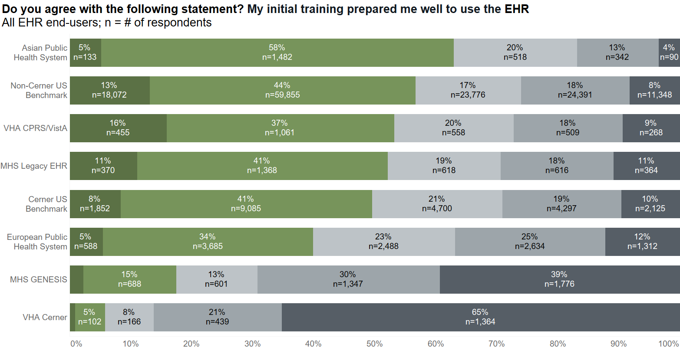
Notes:
% of Total Count of Initial Training Prepared Me Well along Initial Training Prepared Me Well COUNT([Initial Training Prepared Me Well]) / TOTAL(COUNT([Ini... along Initial Training Prepared Me Well Count of Initial Training Prepared Me Well
Asian Public Health System Strongly disagree 4% 4% 90
Asian Public Health System Disagree 13% 13% 342
Asian Public Health System Indifferent 20% 20% 518
Asian Public Health System Agree 58% 58% 1,482
Asian Public Health System Strongly agree 5% 5% 133
Non-Cerner US Benchmark Strongly disagree 8% 8% 11,348
Non-Cerner US Benchmark Disagree 18% 18% 24,391
Non-Cerner US Benchmark Indifferent 17% 17% 23,776
Non-Cerner US Benchmark Agree 44% 44% 59,855
Non-Cerner US Benchmark Strongly agree 13% 13% 18,072
VHA CPRS/VistA Strongly disagree 9% 9% 268
VHA CPRS/VistA Disagree 18% 18% 509
VHA CPRS/VistA Indifferent 20% 20% 558
VHA CPRS/VistA Agree 37% 37% 1,061
VHA CPRS/VistA Strongly agree 16% 16% 455
MHS Legacy EHR Strongly disagree 11% 11% 364
MHS Legacy EHR Disagree 18% 18% 616
MHS Legacy EHR Indifferent 19% 19% 618
MHS Legacy EHR Agree 41% 41% 1,368
MHS Legacy EHR Strongly agree 11% 11% 370
Cerner US Benchmark Strongly disagree 10% 10% 2,125
Cerner US Benchmark Disagree 19% 19% 4,297
Cerner US Benchmark Indifferent 21% 21% 4,700
Cerner US Benchmark Agree 41% 41% 9,085
Cerner US Benchmark Strongly agree 8% 8% 1,852
European Public Health System Strongly disagree 12% 12% 1,312
European Public Health System Disagree 25% 25% 2,634
European Public Health System Indifferent 23% 23% 2,488
European Public Health System Agree 34% 34% 3,685
European Public Health System Strongly agree 5% 5% 588
MHS GENESIS Strongly disagree 39% 39% 1,776
MHS GENESIS Disagree 30% 30% 1,347
MHS GENESIS Indifferent 13% 13% 601
MHS GENESIS Agree 15% 15% 688
MHS GENESIS Strongly agree 2% 2% 103
VHA Cerner Strongly disagree 65% 65% 1,364
VHA Cerner Disagree 21% 21% 439
VHA Cerner Indifferent 8% 8% 166
VHA Cerner Agree 5% 5% 102
VHA Cerner Strongly agree 1% 1% 20

Slide 59
How many education tracks were offered at go-live?

Slide 60
How many hours of education are mandatory and voluntary during go-live?

Slide 61
Education Best Practices
Should have 8–10 hours of onboarding EHR education
Education should be taught by a clinician, or a trainer educated in clinician workflows
a. Education materials should be unique to each clinical workflow and approved by a clinician practicing in that workflow
Education should have a portion that is simulated and live

Slide 62
8 to 10 hours is what is typically needed to onboard a clinician onto the EHR
Notes:
https://klasresearch.com/archcollaborative/report/arch-collaborative-guidebook-2020/343
https://klasresearch.com/archcollaborative/report/arch-collaborative-nursing-guidebook-2022/452

Slide 63
Trainers must understand clinician workflows to be credible and effective
Notes:
https://klasresearch.com/archcollaborative/report/arch-collaborative-guidebook-2020/343

Slide 64
Simulation training makes a difference for both providers and nurses
Notes:
https://klasresearch.com/archcollaborative/report/clinician-training-2021-update/379
https://klasresearch.com/archcollaborative/report/arch-collaborative-nursing-guidebook-2022/452

Slide 65
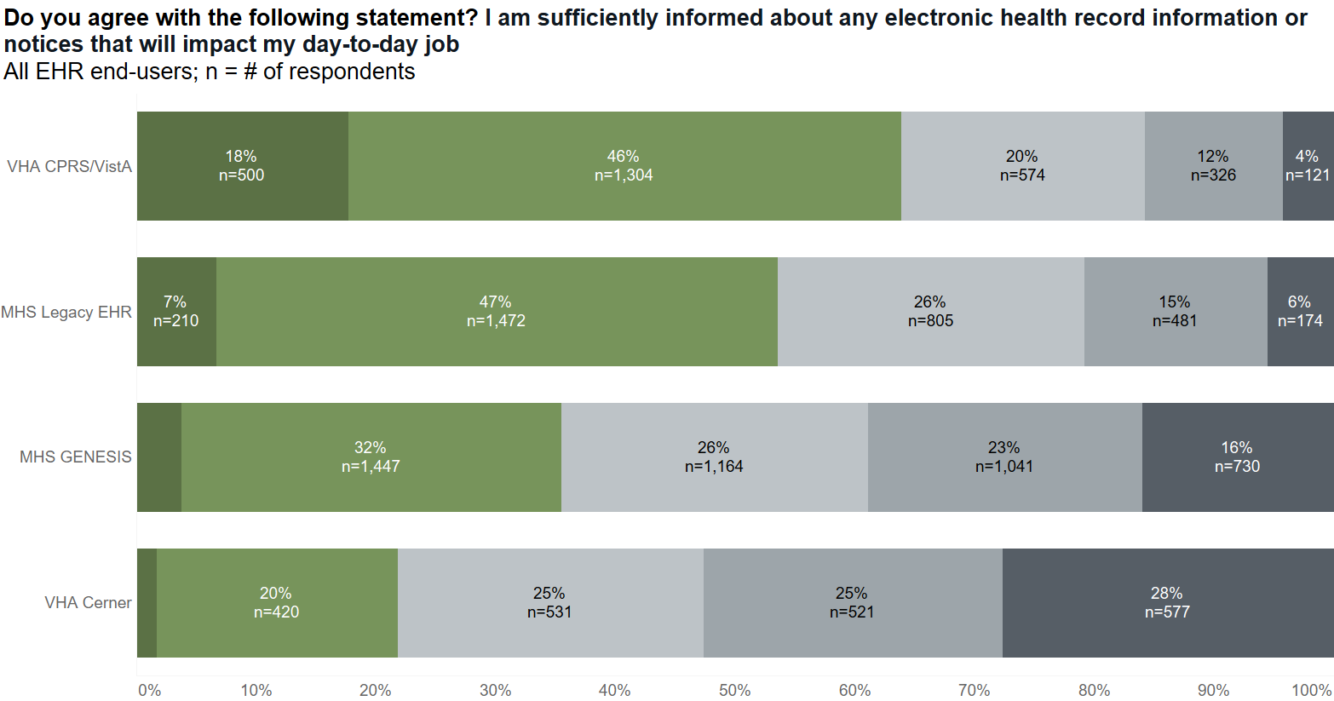
Notes:
% of Total Count of DODSufficiently Informed along DODSufficiently Informed Count of DODSufficiently Informed
VHA CPRS/VistA 0% 0
VHA CPRS/VistA Strongly disagree 4% 121
VHA CPRS/VistA Disagree 12% 326
VHA CPRS/VistA Indifferent 20% 574
VHA CPRS/VistA Agree 46% 1,304
VHA CPRS/VistA Strongly agree 18% 500
MHS Legacy EHR 0% 0
MHS Legacy EHR Strongly disagree 6% 174
MHS Legacy EHR Disagree 15% 481
MHS Legacy EHR Indifferent 26% 805
MHS Legacy EHR Agree 47% 1,472
MHS Legacy EHR Strongly agree 7% 210
MHS GENESIS Strongly disagree 16% 730
MHS GENESIS Disagree 23% 1,041
MHS GENESIS Indifferent 26% 1,164
MHS GENESIS Agree 32% 1,447
MHS GENESIS Strongly agree 4% 170
VHA Cerner 0% 0
VHA Cerner Strongly disagree 28% 577
VHA Cerner Disagree 25% 521
VHA Cerner Indifferent 25% 531
VHA Cerner Agree 20% 420
VHA Cerner Strongly agree 2% 36

Slide 66
Governance Best Practices
Successful organizations have a fast track for quick, obvious EHR changes.
Requests should follow a consistent process.
Organizations with broad, multidisciplinary team engagement in EHR governance see higher EHR satisfaction; governance should be led by a clinician, an IT/informatics leader, and an administrative leader.

Slide 67
There Should Be a Fast Track to Changes
Notes:
https://klasresearch.com/archcollaborative/report/arch-collaborative-guidebook-2020/343

Slide 68

Kaiser Permanente Northwest Pyramid of Change
Kaiser Permanente Northwest identified a root cause of EMR frustration and created a way for clinicians to feel empowered by their EMR.
Keys to Success
It is important for organization leaders to maintain communication with clinical EMR end users, learn end users' workflow needs, and attempt to meet their requests.
Clinicians need to feel that the EMR is supported by people who understand that the EMR is a clinical aide, not a billing or IT tool.
Outcomes
99th percentile for overall provider satisfaction.
99th percentile for agreement that IT leadership has implemented and supported the EMR well.

Slide 69
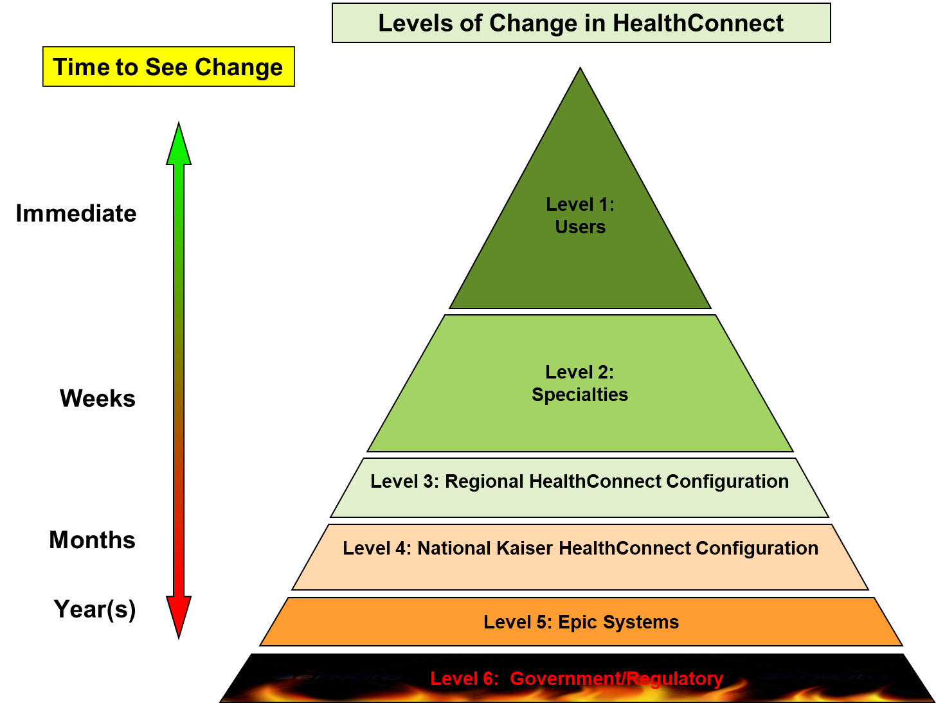

Slide 70
What do results mean in context of the experience with other healthcare systems and where we are with our process?

Slide 71
Though still in early deployment phases, initial education lags the industry
Notes:
% of Total Count of Initial Training Prepared Me Well along Initial Training Prepared Me Well COUNT([Initial Training Prepared Me Well]) / TOTAL(COUNT([Ini... along Initial Training Prepared Me Well Count of Initial Training Prepared Me Well
Asian Public Health System Strongly disagree 4% 4% 90
Asian Public Health System Disagree 13% 13% 342
Asian Public Health System Indifferent 20% 20% 518
Asian Public Health System Agree 58% 58% 1,482
Asian Public Health System Strongly agree 5% 5% 133
Non-Cerner US Benchmark Strongly disagree 8% 8% 11,348
Non-Cerner US Benchmark Disagree 18% 18% 24,391
Non-Cerner US Benchmark Indifferent 17% 17% 23,776
Non-Cerner US Benchmark Agree 44% 44% 59,855
Non-Cerner US Benchmark Strongly agree 13% 13% 18,072
VHA CPRS/VistA Strongly disagree 9% 9% 268
VHA CPRS/VistA Disagree 18% 18% 509
VHA CPRS/VistA Indifferent 20% 20% 558
VHA CPRS/VistA Agree 37% 37% 1,061
VHA CPRS/VistA Strongly agree 16% 16% 455
MHS Legacy EHR Strongly disagree 11% 11% 364
MHS Legacy EHR Disagree 18% 18% 616
MHS Legacy EHR Indifferent 19% 19% 618
MHS Legacy EHR Agree 41% 41% 1,368
MHS Legacy EHR Strongly agree 11% 11% 370
Cerner US Benchmark Strongly disagree 10% 10% 2,125
Cerner US Benchmark Disagree 19% 19% 4,297
Cerner US Benchmark Indifferent 21% 21% 4,700
Cerner US Benchmark Agree 41% 41% 9,085
Cerner US Benchmark Strongly agree 8% 8% 1,852
European Public Health System Strongly disagree 12% 12% 1,312
European Public Health System Disagree 25% 25% 2,634
European Public Health System Indifferent 23% 23% 2,488
European Public Health System Agree 34% 34% 3,685
European Public Health System Strongly agree 5% 5% 588
MHS GENESIS Strongly disagree 39% 39% 1,776
MHS GENESIS Disagree 30% 30% 1,347
MHS GENESIS Indifferent 13% 13% 601
MHS GENESIS Agree 15% 15% 688
MHS GENESIS Strongly agree 2% 2% 103
VHA Cerner Strongly disagree 65% 65% 1,364
VHA Cerner Disagree 21% 21% 439
VHA Cerner Indifferent 8% 8% 166
VHA Cerner Agree 5% 5% 102
VHA Cerner Strongly agree 1% 1% 20

Slide 72
In comparing with the industry, what makes the Government a different animal from the baseline orgs (Aside from bureaucracy)?

Slide 73
Qualitative difference of government vs. the industry
Governance structure to be adopted is much more restricted
While many hire consultants and third parties to help with education at go-live, much larger focus is placed on developing local expertise in the EHR.
Many in the industry struggle to deploy and maintain ongoing EHR education, however there are several large health systems who have been able to deploy new programs and dramatically improve the EHR experience

Slide 74
Would be good to compare context from DoD to VA in their timeline.

Slide 75
VA and DoD Cerner have both poor initial education
Notes:
2020 data from MHS Genesis still outperforms initial education ratings for the deployment in VISN 10 and VISN 20
% of Total Count of Initial Training Prepared Me Well along Initial Training Prepared Me Well COUNT([Initial Training Prepared Me Well]) / TOTAL(COUNT([Ini... along Initial Training Prepared Me Well Count of Initial Training Prepared Me Well
Asian Public Health System Strongly disagree 4% 4% 90
Asian Public Health System Disagree 13% 13% 342
Asian Public Health System Indifferent 20% 20% 518
Asian Public Health System Agree 58% 58% 1,482
Asian Public Health System Strongly agree 5% 5% 133
Non-Cerner US Benchmark Strongly disagree 8% 8% 11,348
Non-Cerner US Benchmark Disagree 18% 18% 24,391
Non-Cerner US Benchmark Indifferent 17% 17% 23,776
Non-Cerner US Benchmark Agree 44% 44% 59,855
Non-Cerner US Benchmark Strongly agree 13% 13% 18,072
VHA CPRS/VistA Strongly disagree 9% 9% 268
VHA CPRS/VistA Disagree 18% 18% 509
VHA CPRS/VistA Indifferent 20% 20% 558
VHA CPRS/VistA Agree 37% 37% 1,061
VHA CPRS/VistA Strongly agree 16% 16% 455
MHS Legacy EHR Strongly disagree 11% 11% 364
MHS Legacy EHR Disagree 18% 18% 616
MHS Legacy EHR Indifferent 19% 19% 618
MHS Legacy EHR Agree 41% 41% 1,368
MHS Legacy EHR Strongly agree 11% 11% 370
Cerner US Benchmark Strongly disagree 10% 10% 2,125
Cerner US Benchmark Disagree 19% 19% 4,297
Cerner US Benchmark Indifferent 21% 21% 4,700
Cerner US Benchmark Agree 41% 41% 9,085
Cerner US Benchmark Strongly agree 8% 8% 1,852
European Public Health System Strongly disagree 12% 12% 1,312
European Public Health System Disagree 25% 25% 2,634
European Public Health System Indifferent 23% 23% 2,488
European Public Health System Agree 34% 34% 3,685
European Public Health System Strongly agree 5% 5% 588
MHS GENESIS Strongly disagree 39% 39% 1,776
MHS GENESIS Disagree 30% 30% 1,347
MHS GENESIS Indifferent 13% 13% 601
MHS GENESIS Agree 15% 15% 688
MHS GENESIS Strongly agree 2% 2% 103
VHA Cerner Strongly disagree 65% 65% 1,364
VHA Cerner Disagree 21% 21% 439
VHA Cerner Indifferent 8% 8% 166
VHA Cerner Agree 5% 5% 102
VHA Cerner Strongly agree 1% 1% 20

Slide 76
What is the biggest opportunity for improvement?

Slide 77
Notes:
COUNT([Satisfaction Reliability Response]) / TOTAL(COUNT([Sat... along Satisfaction Reliability Response COUNT([Satisfaction Reliability Response]) / TOTAL(COUNT([Sat... along Satisfaction Reliability Response Count of Satisfaction Reliability Response
VHA CPRS/VistA 0% 0% 0
VHA CPRS/VistA Strongly disagree 3% 3% 77
VHA CPRS/VistA Disagree 6% 6% 173
VHA CPRS/VistA Indifferent 9% 9% 253
VHA CPRS/VistA Agree 39% 39% 1,097
VHA CPRS/VistA Strongly agree 44% 44% 1,249
Non-Cerner US Benchmark 0% 0% 0
Non-Cerner US Benchmark Strongly disagree 2% 2% 2,724
Non-Cerner US Benchmark Disagree 6% 6% 8,485
Non-Cerner US Benchmark Indifferent 11% 11% 14,253
Non-Cerner US Benchmark Agree 51% 51% 67,546
Non-Cerner US Benchmark Strongly agree 29% 29% 38,618
Asian Public Health System 0% 0% 0
Asian Public Health System Strongly disagree 4% 4% 84
Asian Public Health System Disagree 13% 13% 314
Asian Public Health System Indifferent 15% 15% 357
Asian Public Health System Agree 52% 52% 1,216
Asian Public Health System Strongly agree 16% 16% 365
Cerner US Benchmark 0% 0% 0
Cerner US Benchmark Strongly disagree 4% 4% 807
Cerner US Benchmark Disagree 12% 12% 2,347
Cerner US Benchmark Indifferent 16% 16% 3,213
Cerner US Benchmark Agree 51% 51% 9,984
Cerner US Benchmark Strongly agree 17% 17% 3,250
European Public Health System 0% 0% 0
European Public Health System Strongly disagree 7% 7% 731
European Public Health System Disagree 18% 18% 1,958
European Public Health System Indifferent 18% 18% 1,945
European Public Health System Agree 43% 43% 4,655
European Public Health System Strongly agree 14% 14% 1,531
MHS Legacy EHR 0% 0% 0
MHS Legacy EHR Strongly disagree 12% 12% 399
MHS Legacy EHR Disagree 27% 27% 869
MHS Legacy EHR Indifferent 16% 16% 513
MHS Legacy EHR Agree 37% 37% 1,187
MHS Legacy EHR Strongly agree 8% 8% 265
MHS GENESIS Strongly Disagree 23% 23% 1,048
MHS GENESIS Disagree 35% 35% 1,591
MHS GENESIS Indifferent 16% 16% 736
MHS GENESIS Agree 22% 22% 1,019
MHS GENESIS Strongly agree 3% 3% 158
VHA Cerner 0% 0% 0
VHA Cerner Strongly disagree 39% 39% 820
VHA Cerner Disagree 32% 32% 672
VHA Cerner Indifferent 12% 12% 251
VHA Cerner Agree 15% 15% 306
VHA Cerner Strongly agree 2% 2% 39

Slide 78
Notes:
% of Total Count of Initial Training Prepared Me Well along Initial Training Prepared Me Well COUNT([Initial Training Prepared Me Well]) / TOTAL(COUNT([Ini... along Initial Training Prepared Me Well Count of Initial Training Prepared Me Well
Asian Public Health System Strongly disagree 4% 4% 90
Asian Public Health System Disagree 13% 13% 342
Asian Public Health System Indifferent 20% 20% 518
Asian Public Health System Agree 58% 58% 1,482
Asian Public Health System Strongly agree 5% 5% 133
Non-Cerner US Benchmark Strongly disagree 8% 8% 11,348
Non-Cerner US Benchmark Disagree 18% 18% 24,391
Non-Cerner US Benchmark Indifferent 17% 17% 23,776
Non-Cerner US Benchmark Agree 44% 44% 59,855
Non-Cerner US Benchmark Strongly agree 13% 13% 18,072
VHA CPRS/VistA Strongly disagree 9% 9% 268
VHA CPRS/VistA Disagree 18% 18% 509
VHA CPRS/VistA Indifferent 20% 20% 558
VHA CPRS/VistA Agree 37% 37% 1,061
VHA CPRS/VistA Strongly agree 16% 16% 455
MHS Legacy EHR Strongly disagree 11% 11% 364
MHS Legacy EHR Disagree 18% 18% 616
MHS Legacy EHR Indifferent 19% 19% 618
MHS Legacy EHR Agree 41% 41% 1,368
MHS Legacy EHR Strongly agree 11% 11% 370
Cerner US Benchmark Strongly disagree 10% 10% 2,125
Cerner US Benchmark Disagree 19% 19% 4,297
Cerner US Benchmark Indifferent 21% 21% 4,700
Cerner US Benchmark Agree 41% 41% 9,085
Cerner US Benchmark Strongly agree 8% 8% 1,852
European Public Health System Strongly disagree 12% 12% 1,312
European Public Health System Disagree 25% 25% 2,634
European Public Health System Indifferent 23% 23% 2,488
European Public Health System Agree 34% 34% 3,685
European Public Health System Strongly agree 5% 5% 588
MHS GENESIS Strongly disagree 39% 39% 1,776
MHS GENESIS Disagree 30% 30% 1,347
MHS GENESIS Indifferent 13% 13% 601
MHS GENESIS Agree 15% 15% 688
MHS GENESIS Strongly agree 2% 2% 103
VHA Cerner Strongly disagree 65% 65% 1,364
VHA Cerner Disagree 21% 21% 439
VHA Cerner Indifferent 8% 8% 166
VHA Cerner Agree 5% 5% 102
VHA Cerner Strongly agree 1% 1% 20

Slide 79
What are standard approaches in industry to address the results?

Slide 80
Case Study: Intermountain Healthcare and Goliath Technologies
Outcomes
26% increase in agreement that the EHR is reliable
22% increase in agreement that the EHR has fast system response time
What Intermountain Healthcare and Goliath Technologies Did
Spent 18 months rolling out solution before go-live
Had real-time monitoring of reliability and response time metrics
Identified where the system wasn’t working

Slide 81
Education Best Practices
Should have 8–10 hours of onboarding EHR education
Education should be taught by a clinician, or a trainer educated in clinician workflows
a. Education materials should be unique to each clinical workflow and approved by a clinician practicing in that workflow
Education should have a portion that is simulated/live

Slide 82
8 to 10 hours is what is typically needed to onboard a clinician onto the EHR
Notes:
https://klasresearch.com/archcollaborative/report/arch-collaborative-guidebook-2020/343
https://klasresearch.com/archcollaborative/report/arch-collaborative-nursing-guidebook-2022/452

Slide 83
Trainers must understand clinician workflows to be credible and effective
Notes:
https://klasresearch.com/archcollaborative/report/arch-collaborative-guidebook-2020/343

Slide 84
Simulation training makes a difference for both providers and nurses
Notes:
https://klasresearch.com/archcollaborative/report/clinician-training-2021-update/379
https://klasresearch.com/archcollaborative/report/arch-collaborative-nursing-guidebook-2022/452

Slide 85
What do we recommend the VHA do to address the opportunity?

Slide 86
Potential action items from best practices
Adopt or create a technology that allows for real-time tracking of the infrastructure and interfaces that may affect the EHR
Adopt best practices for initial education of end-users
Teach to end-user workflows
Have 8–10 hours before go-live
A portion should be simulated or live
Reboot education for VISN 10 and VISN 20
Improve communication channels for changes and decision-making
Have a fast track for quick fixes
Ensure all end-users understand pathways
Always circle back to end-users when a request is sent

Slide 87
What is a good improvement goal?

Slide 88
20% jump is possible and is likely a good first goal
Arch Collaborative Findings (excludes VHA)

Slide 89
Initial education should be at least 50% to potentially obtain long-term success
Notes:
% of Total Count of Initial Training Prepared Me Well along Initial Training Prepared Me Well COUNT([Initial Training Prepared Me Well]) / TOTAL(COUNT([Ini... along Initial Training Prepared Me Well Count of Initial Training Prepared Me Well
Asian Public Health System Strongly disagree 4% 4% 90
Asian Public Health System Disagree 13% 13% 342
Asian Public Health System Indifferent 20% 20% 518
Asian Public Health System Agree 58% 58% 1,482
Asian Public Health System Strongly agree 5% 5% 133
Non-Cerner US Benchmark Strongly disagree 8% 8% 11,348
Non-Cerner US Benchmark Disagree 18% 18% 24,391
Non-Cerner US Benchmark Indifferent 17% 17% 23,776
Non-Cerner US Benchmark Agree 44% 44% 59,855
Non-Cerner US Benchmark Strongly agree 13% 13% 18,072
VHA CPRS/VistA Strongly disagree 9% 9% 268
VHA CPRS/VistA Disagree 18% 18% 509
VHA CPRS/VistA Indifferent 20% 20% 558
VHA CPRS/VistA Agree 37% 37% 1,061
VHA CPRS/VistA Strongly agree 16% 16% 455
MHS Legacy EHR Strongly disagree 11% 11% 364
MHS Legacy EHR Disagree 18% 18% 616
MHS Legacy EHR Indifferent 19% 19% 618
MHS Legacy EHR Agree 41% 41% 1,368
MHS Legacy EHR Strongly agree 11% 11% 370
Cerner US Benchmark Strongly disagree 10% 10% 2,125
Cerner US Benchmark Disagree 19% 19% 4,297
Cerner US Benchmark Indifferent 21% 21% 4,700
Cerner US Benchmark Agree 41% 41% 9,085
Cerner US Benchmark Strongly agree 8% 8% 1,852
European Public Health System Strongly disagree 12% 12% 1,312
European Public Health System Disagree 25% 25% 2,634
European Public Health System Indifferent 23% 23% 2,488
European Public Health System Agree 34% 34% 3,685
European Public Health System Strongly agree 5% 5% 588
MHS GENESIS Strongly disagree 39% 39% 1,776
MHS GENESIS Disagree 30% 30% 1,347
MHS GENESIS Indifferent 13% 13% 601
MHS GENESIS Agree 15% 15% 688
MHS GENESIS Strongly agree 2% 2% 103
VHA Cerner Strongly disagree 65% 65% 1,364
VHA Cerner Disagree 21% 21% 439
VHA Cerner Indifferent 8% 8% 166
VHA Cerner Agree 5% 5% 102
VHA Cerner Strongly agree 1% 1% 20

Slide 90
What group should we start with?

Slide 91
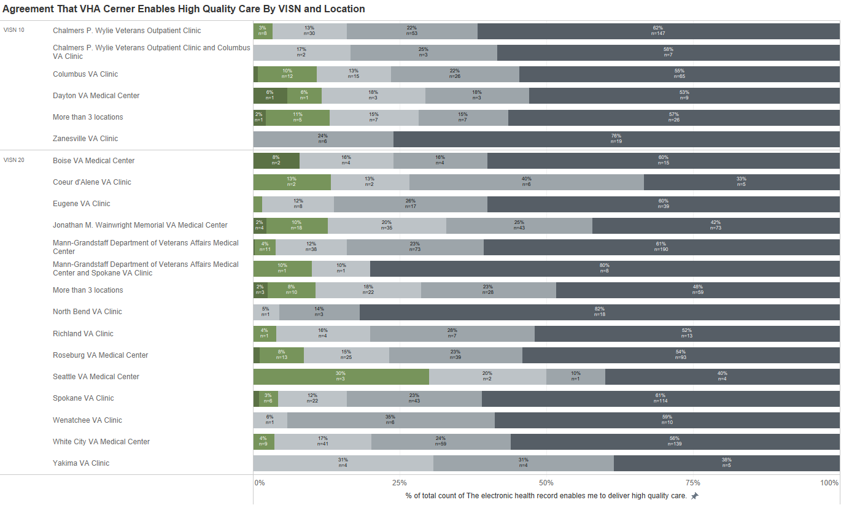
Any location and VISN is a good group to start with

Slide 92
How do we achieve the results? What programs should be put into place?

Slide 93
Case Study: Intermountain Healthcare and Goliath Technologies
Outcomes
26% increase in agreement that the EHR is reliable
22% increase in agreement that the EHR has fast system response time
What Intermountain Healthcare and Goliath Technologies Did
Spent 18 months rolling out solution before go-live
Had real-time monitoring of reliability and response time metrics
Identified where the system wasn’t working

Slide 94
How will we measure the impact?

Slide 95
Pre go-live and post go-live measurements
DoD has been measuring EHR experience using the same instrument pre go-live on their legacy EHR.
Post measurement takes place six months after go-live and represents the changed EHR experience of users

Slide 96
Initial education must be tracked to understand if it’s improving
Notes:
% of Total Count of Initial Training Prepared Me Well along Initial Training Prepared Me Well COUNT([Initial Training Prepared Me Well]) / TOTAL(COUNT([Ini... along Initial Training Prepared Me Well Count of Initial Training Prepared Me Well
Asian Public Health System Strongly disagree 4% 4% 90
Asian Public Health System Disagree 13% 13% 342
Asian Public Health System Indifferent 20% 20% 518
Asian Public Health System Agree 58% 58% 1,482
Asian Public Health System Strongly agree 5% 5% 133
Non-Cerner US Benchmark Strongly disagree 8% 8% 11,348
Non-Cerner US Benchmark Disagree 18% 18% 24,391
Non-Cerner US Benchmark Indifferent 17% 17% 23,776
Non-Cerner US Benchmark Agree 44% 44% 59,855
Non-Cerner US Benchmark Strongly agree 13% 13% 18,072
VHA CPRS/VistA Strongly disagree 9% 9% 268
VHA CPRS/VistA Disagree 18% 18% 509
VHA CPRS/VistA Indifferent 20% 20% 558
VHA CPRS/VistA Agree 37% 37% 1,061
VHA CPRS/VistA Strongly agree 16% 16% 455
MHS Legacy EHR Strongly disagree 11% 11% 364
MHS Legacy EHR Disagree 18% 18% 616
MHS Legacy EHR Indifferent 19% 19% 618
MHS Legacy EHR Agree 41% 41% 1,368
MHS Legacy EHR Strongly agree 11% 11% 370
Cerner US Benchmark Strongly disagree 10% 10% 2,125
Cerner US Benchmark Disagree 19% 19% 4,297
Cerner US Benchmark Indifferent 21% 21% 4,700
Cerner US Benchmark Agree 41% 41% 9,085
Cerner US Benchmark Strongly agree 8% 8% 1,852
European Public Health System Strongly disagree 12% 12% 1,312
European Public Health System Disagree 25% 25% 2,634
European Public Health System Indifferent 23% 23% 2,488
European Public Health System Agree 34% 34% 3,685
European Public Health System Strongly agree 5% 5% 588
MHS GENESIS Strongly disagree 39% 39% 1,776
MHS GENESIS Disagree 30% 30% 1,347
MHS GENESIS Indifferent 13% 13% 601
MHS GENESIS Agree 15% 15% 688
MHS GENESIS Strongly agree 2% 2% 103
VHA Cerner Strongly disagree 65% 65% 1,364
VHA Cerner Disagree 21% 21% 439
VHA Cerner Indifferent 8% 8% 166
VHA Cerner Agree 5% 5% 102
VHA Cerner Strongly agree 1% 1% 20

Slide 97
Need to know about what to do with all the competing surveys.

Slide 98
Pre and post measurements can likely be adjusted to include other relevant questions being asked.
Pre and post measurement might be postponed if an annual EHR end-user survey is sent to all VISN’s and EHRs
The previous year’s measurement of CPRS would be used as the “Pre” and all future measurements of Cerner could be measured against this benchmark.
Timing of the annual survey would be best placed at least 3 months after the last go-live.

Slide 99
Next Steps?

Slide 100
What additional breakouts can KLAS provide?

Slide 101
What additional calls/presentations can KLAS provide?

Slide 102
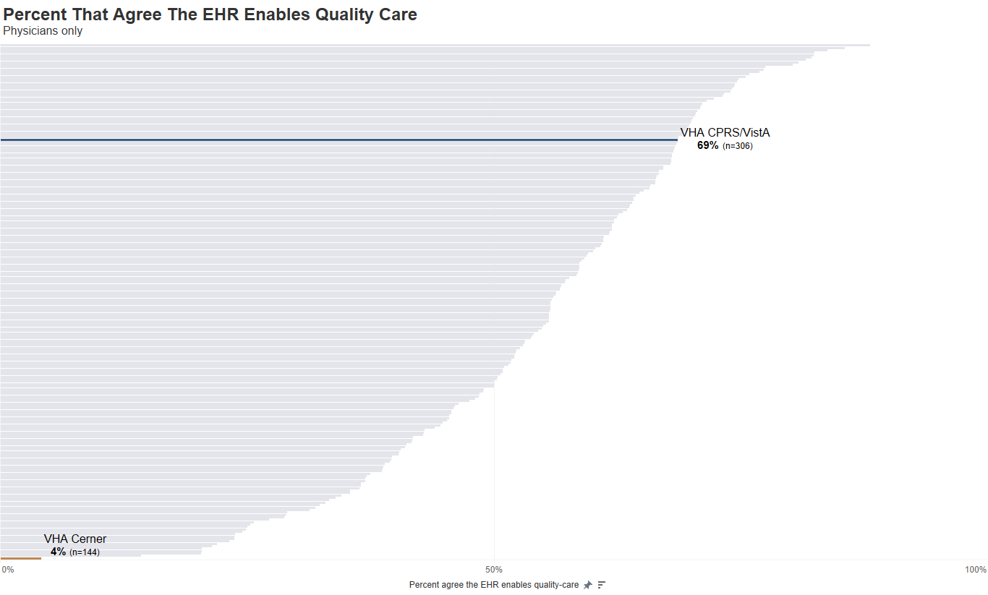

Slide 103
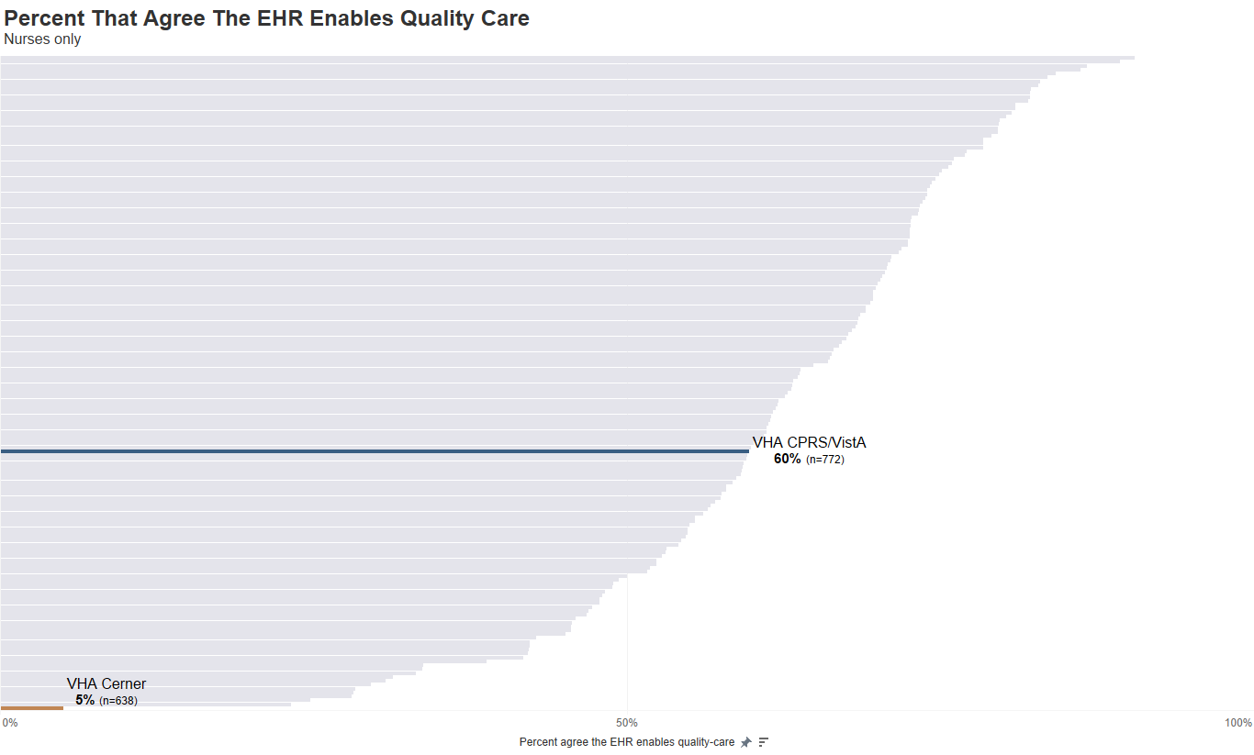

Slide 104
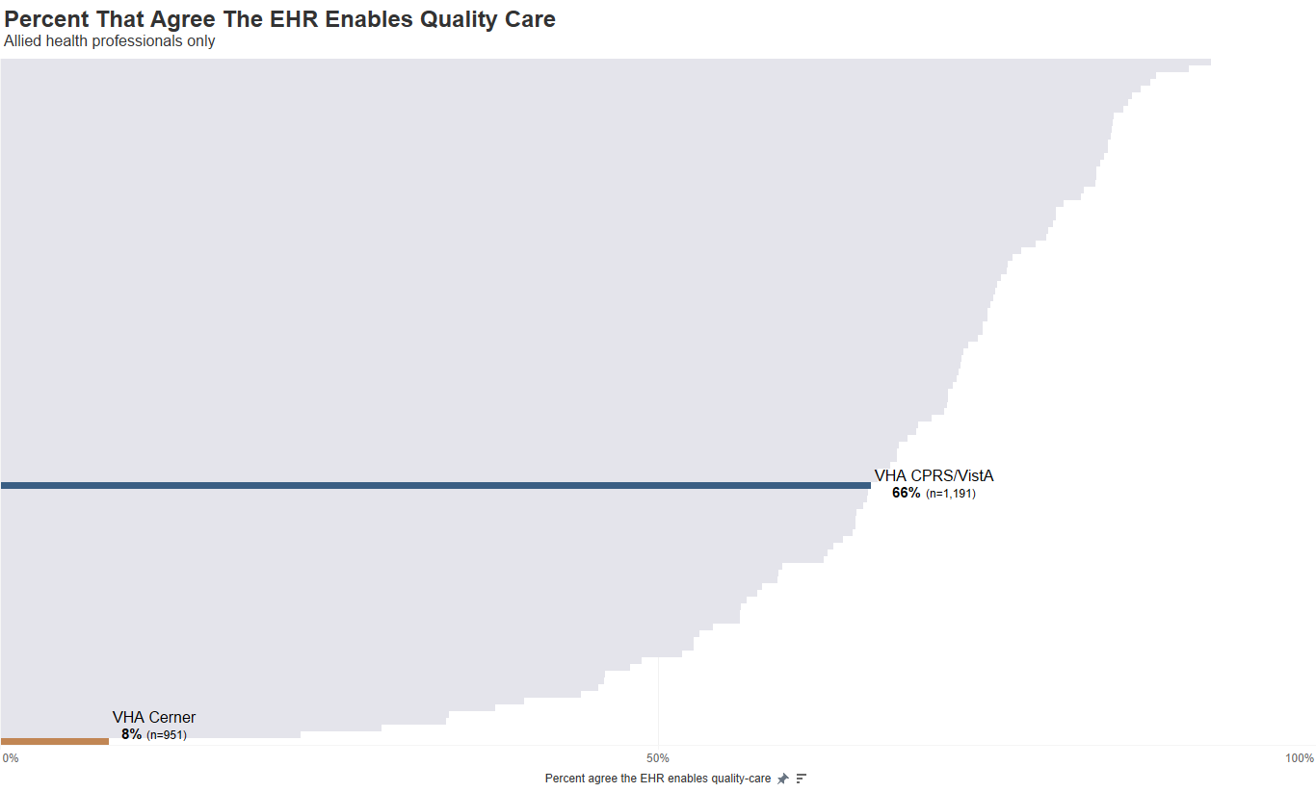

Slide 105
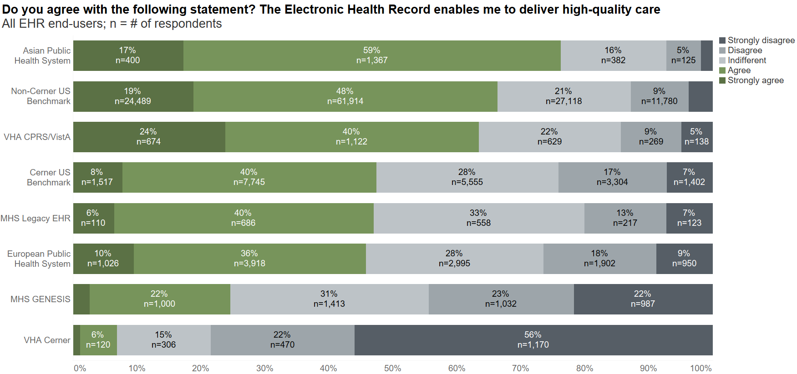

Slide 106
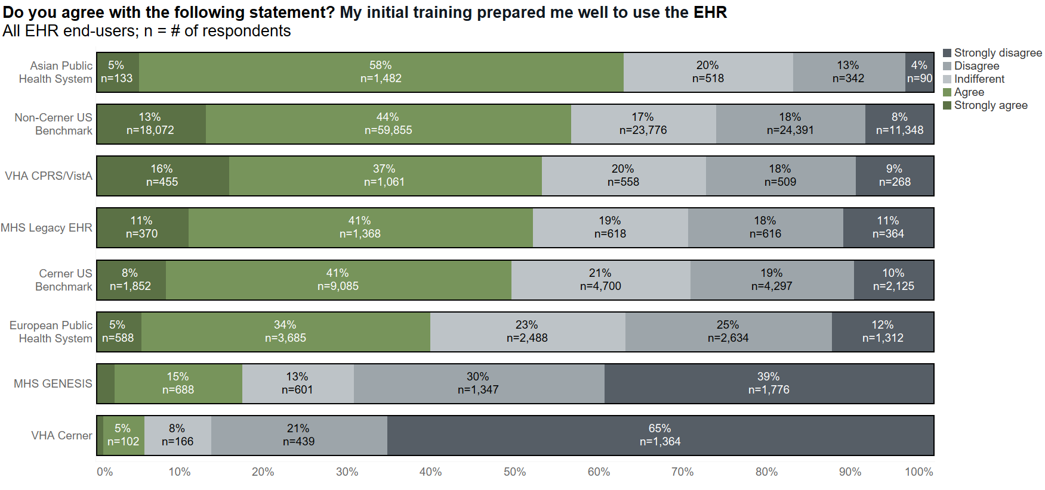

Slide 107
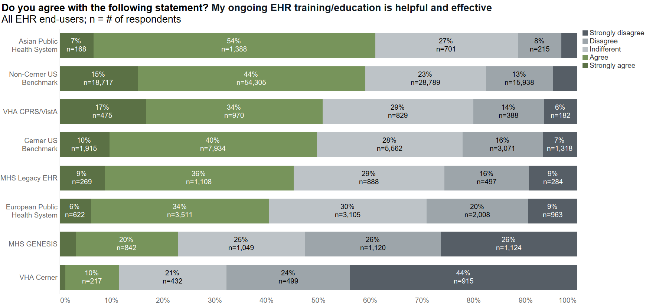

Slide 108
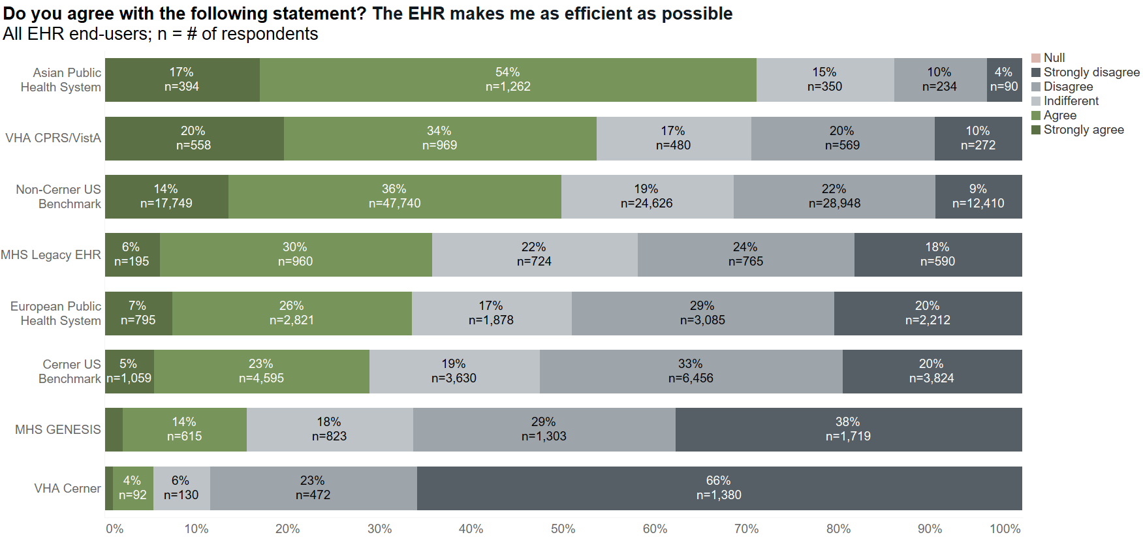

Slide 109
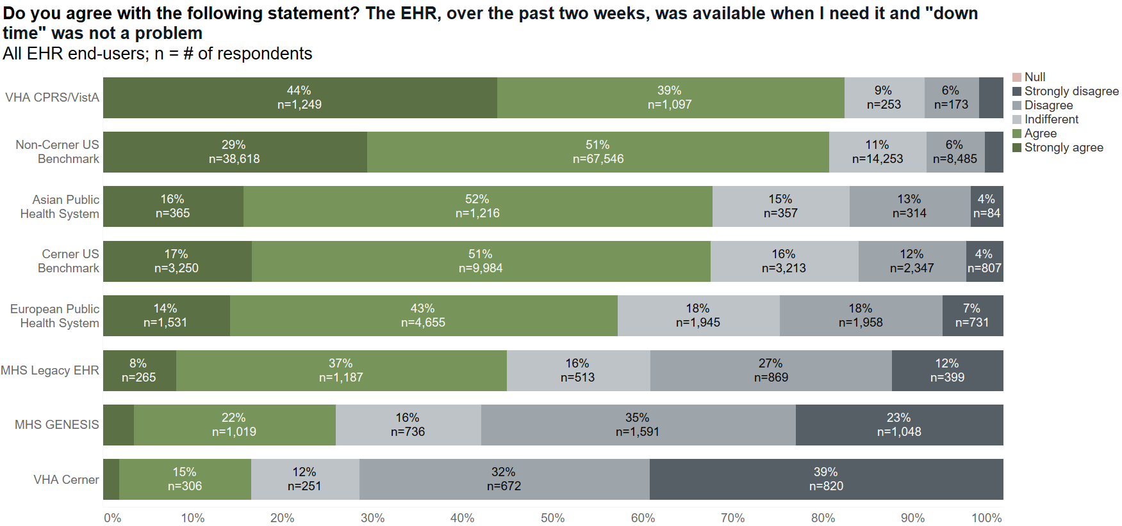

Slide 110
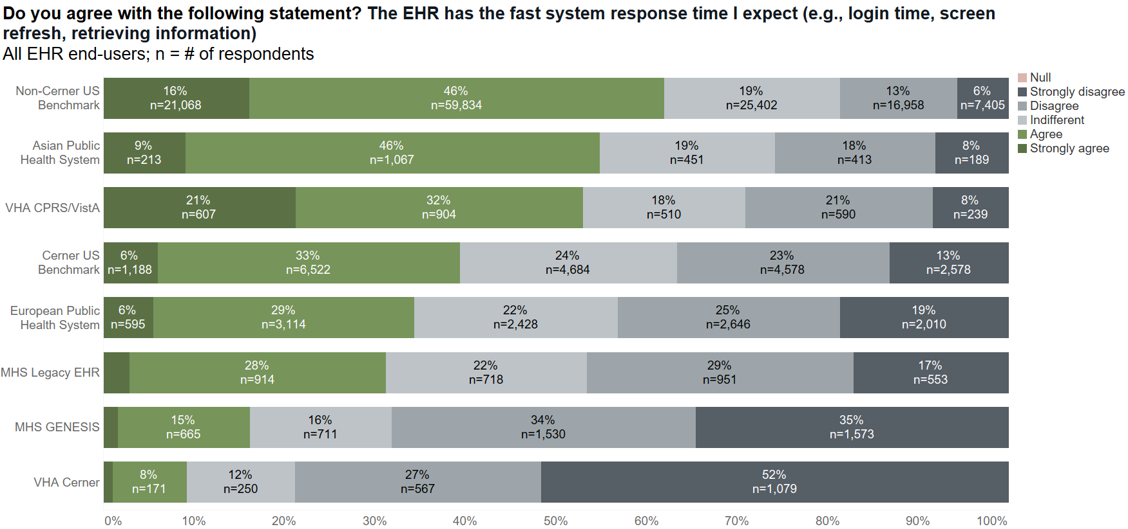

Slide 111
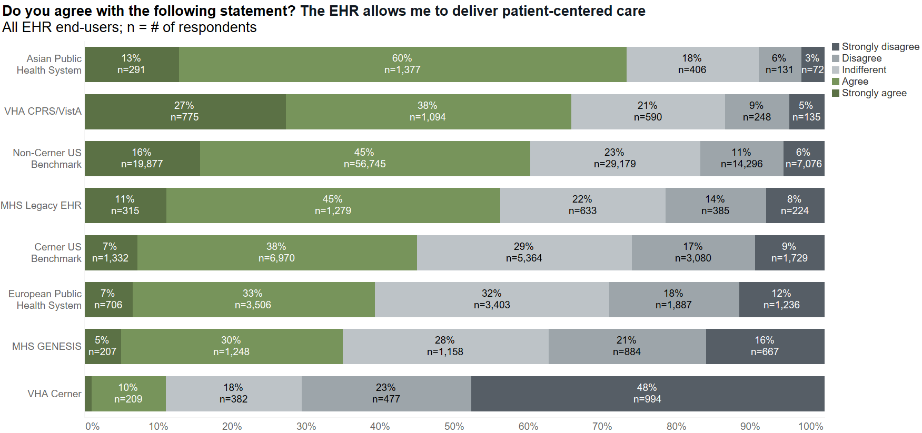

Slide 113
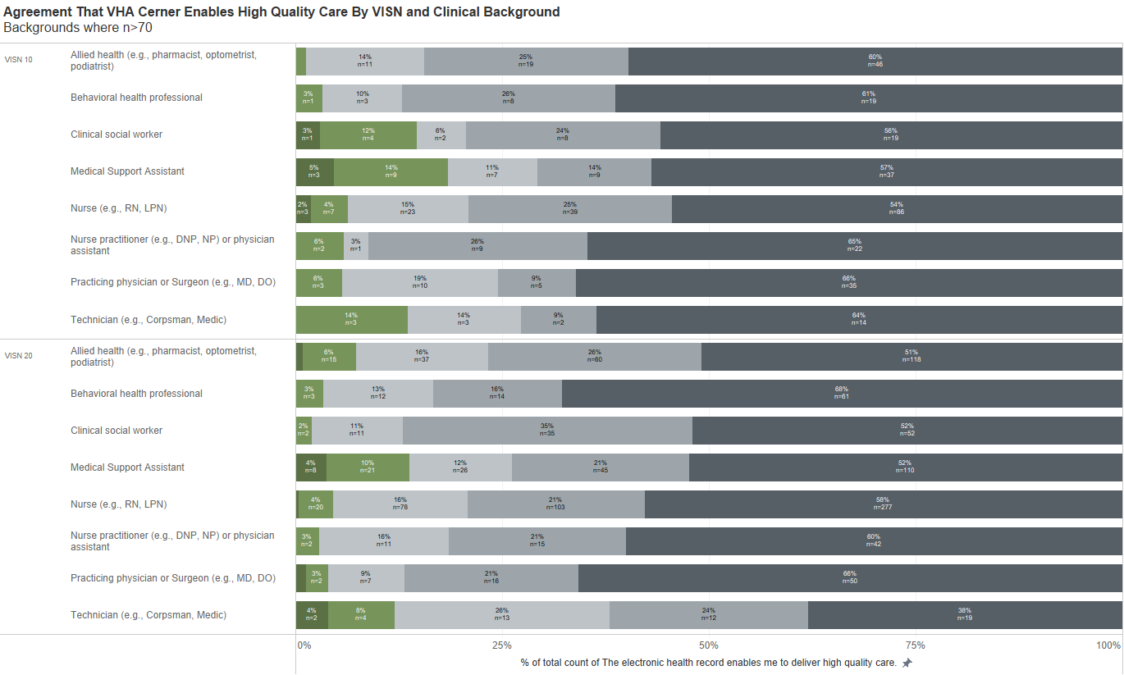

Slide 114


Slide 115


Slide 116


Slide 117


Slide 118


Slide 119


Slide 120


Slide 121


Slide 122


Slide 123


Slide 124


Slide 125


Slide 126


Slide 127


Slide 128


Slide 129


Slide 130


Slide 131


Slide 132


Slide 133


Slide 134


Slide 135


Slide 136


